Slide 1
Endocannabinoid System and Phytocannabinoids
Medical Marijuana Oversight Committee

Slide 2
Introduction
Jeremy Barthels, MS, DC
  Department Chair at NWHSU
  NWSHU Associate Faculty Member- Basic Sciences
  Chronic Pain Patient
  Do not have advance degrees or direct research in this area
I want to clarify that while I am a department chair and faculty member at Northwestern Health Sciences University, I am participating today in my individual capacity. The educational content and views expressed in this presentation are my own and do not necessarily reflect those of the University. My participation does not imply University endorsement.

Slide 3
Endocannabinoid System (ECS)
A naturally occurring system within our body composed of
  Endocannabinoids
  Receptors
  Enzymes
ECS acts as one of the body’s main homeostatic regulators
  Nervous system coordinates communication
  Endocrine system regulates growth and metabolism
  Endocannabinoid system fine-tunes them both

Slide 4
ECS: Function
Functions/Modulation/Influences of the ECS Include
Neurotransmitter Synaptic Release
Immune System Response and Inflammation Processes
Pain Perception
Appetite and Metabolism Regulation
Mood, Emotional, Sensory Awareness, Stress Regulation, and Time Perception
Wake/Sleep Cycles
Memory and Learning

Slide 5
ECS: Function
1. Regulation
  The ECS continuously fine tunes the activity of other physiological systems to maintain homeostasis
  Modulates neuronal excitability, immune cell function, endocrine balance, and energy metabolism
  Assists in the management of homeostasis
2. Response
  Synthesized on demand to respond locally to internal and external stressors
  Modulate neurotransmitter and cytokine release- dampening overactivity
  In peripheral tissues- limits inflammation and immune overreaction
  In CNS- it prevents excitotoxicity and excessive stress signaling
3. Recovery
  Promotes resilience and adaptation- regain homeostasis faster and efficiently
  ECS ensures efficient recovery, preventing lingering inflammation and neural overactivation

Slide 6
ECS: Organ System Influences
Organ System | ECS Function
Nervous | Regulates neurotransmitter release, neural tone, and pain perception
Endocrine | Modulates HPA axis, stress hormones, and metabolic balance
Immune | Controls cytokine production and inflammation
Digestive | Influences motility, appetite, and gut permeability
Musculoskeletal | Modulates pain, inflammation, and local tissue healing
Emotional/Cognitive | Affects mood, motivation, sensory, and stress adaptation

Slide 7
ECS: Endocannabinoids & Enzymes
Endocannabinoids
  Anandamide (AEA)
  2-Arachidonoyl glycerol (2-AG)
  Synthesized “on demand” from phospholipid precursors in the plasma membrane
    Synthesized and degraded within seconds
  Are classified as autocrine / paracrine in their effects
  Bind to CB1 and CB2 receptors
Endocannabinoid Enzymes
  Assist in the synthesis and breakdown of endocannabinoids

Slide 8
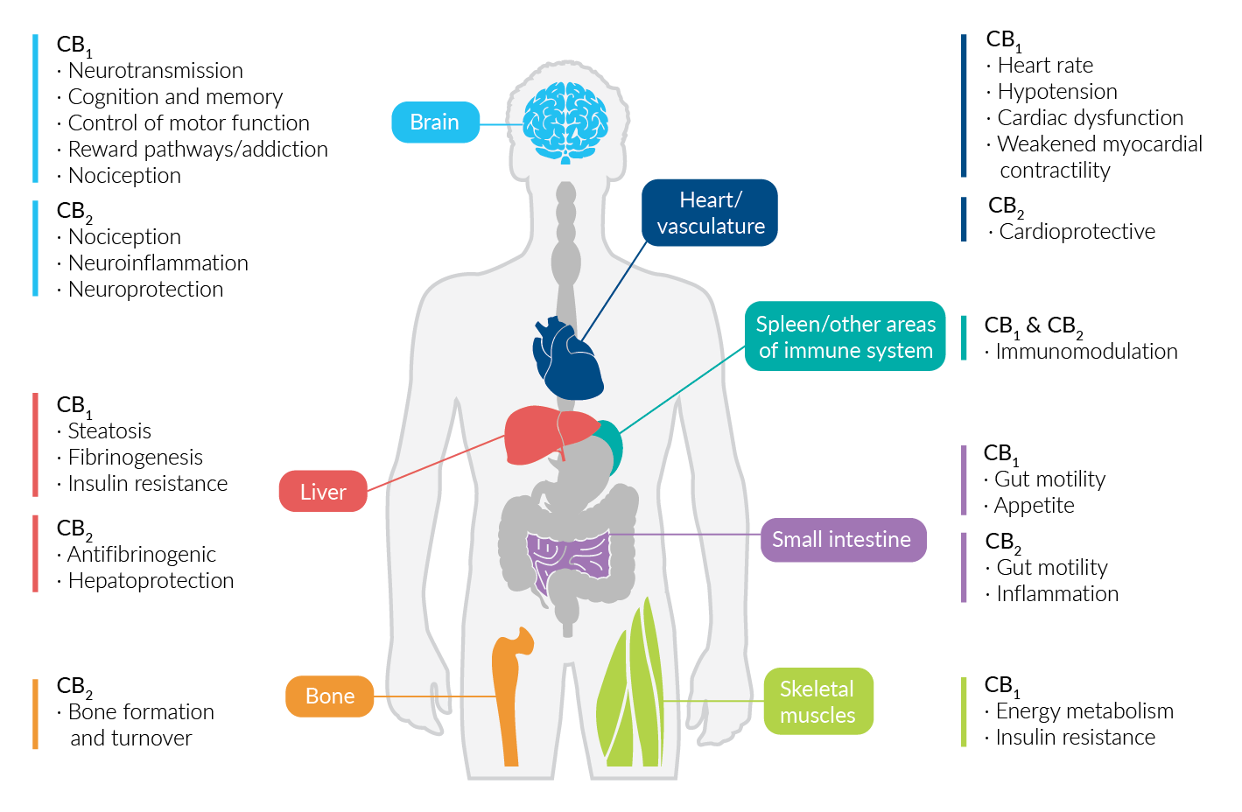
ECS: Receptors
Endocannabinoid Receptors
  CB1 & CB2 receptors
  G protein–coupled receptors
  Binds both endogenous and exogenous cannabinoids and compounds
  Location is key
CB1 primarily within CNS
  Modulates neurotransmitter release and synaptic tone
CB2 primarily within PNS
  Regulates inflammatory processes and immune signaling

Slide 9
ECS: Receptors
CB1 and CB2 receptors are G-protein coupled
Can bind endogenous and exogenous cannabinoids
Once activated- can lead to synaptic modulation and influence of:
  Pain perception
  Inflammation
  Muscle control
  Appetite
  Sleep
  Ocular pressure
  Emotional mood: euphoria, relaxfullness, anxiety, fear, creativity
  Perceptional changes: time, vision, sound

Slide 10
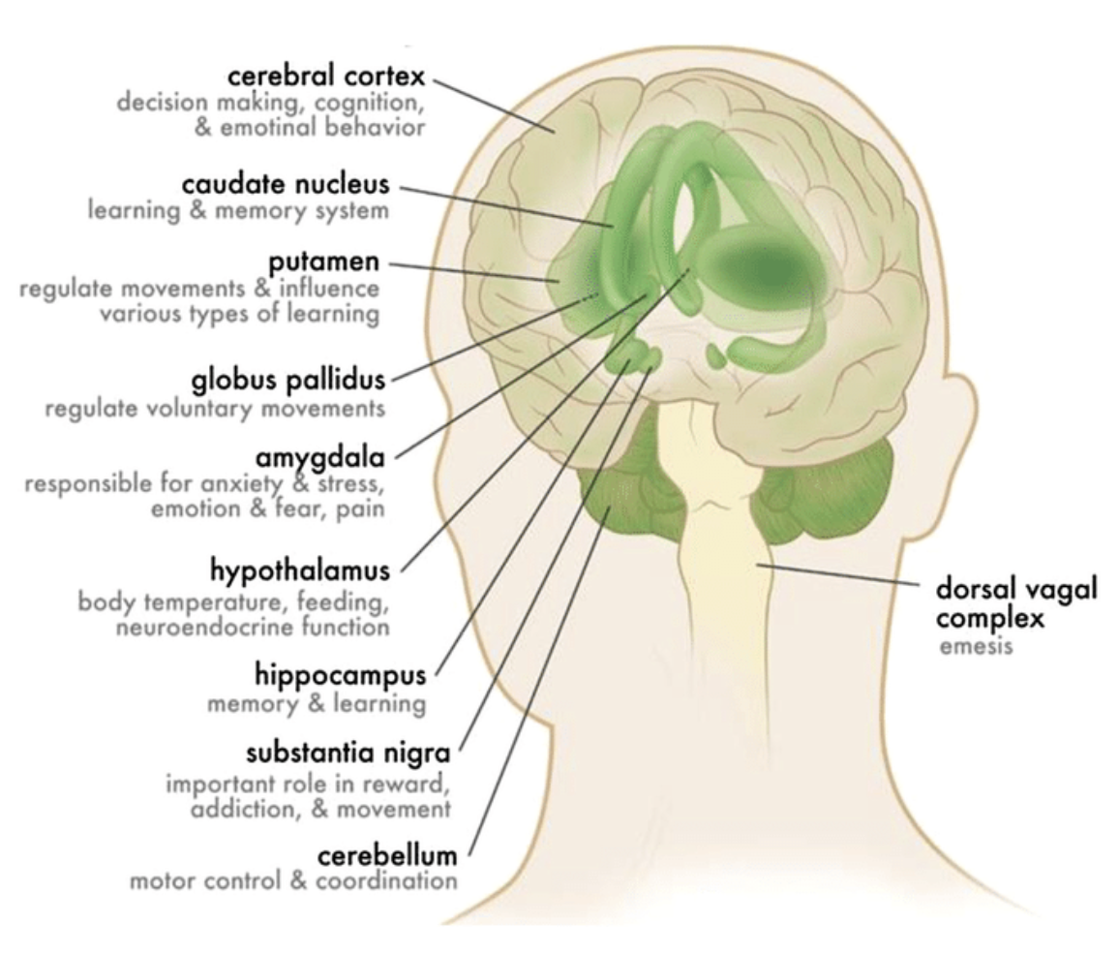
ECS: CB1 Receptors
Found primarily on the presynaptic axon terminals of CNS neurons
When activated inhibits neurotransmitter release from presynaptic neuron
  Retrograde signaling
Also found scattered throughout the body including immune, cardiovascular, gastrointestinal, integument systems

Slide 11
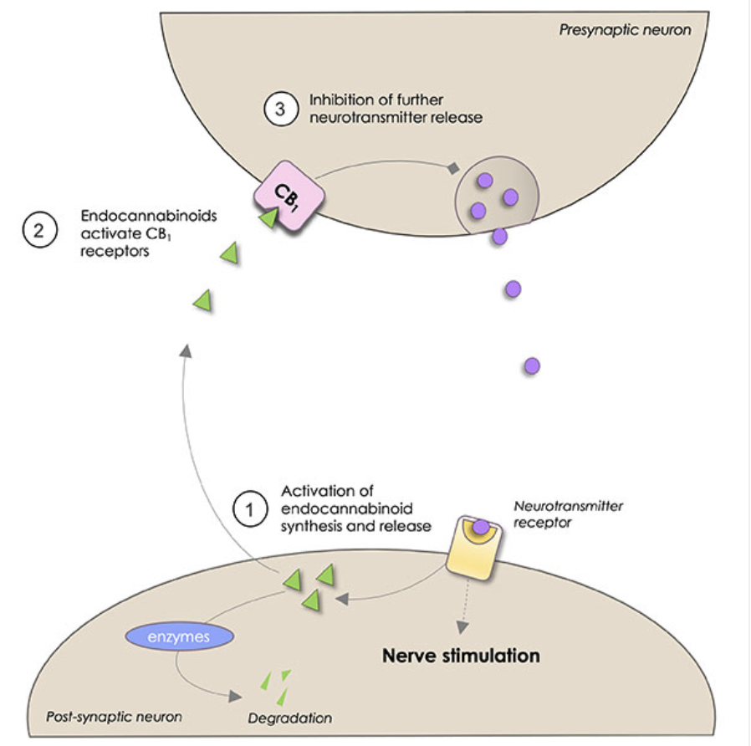
ECS: CB1 Receptors
Retrograde Signaling Physiology
Endocannabinoids released from post-synaptic neuron bind to pre-synaptic neuron’s axon terminal
Modulates release of neurotransmitter
  Glutamate (Glutamatergic neurons)
  GABA (GABAergic neurons)
Regulates synaptic function
Notes:
https://www.cndoctor.ca/the-endocannabinoid-systems-role-in-pain-and-inflammation/

Slide 12
ECS: CB1 Receptors
Once Activated- Can lead to Physiological Modulation
1. Neuroprotection
  Endocannabinoids can protect the brain from overexcitation and potential excitotoxicity, which could otherwise lead to neuronal damage or death
2. Regulation of Mood, Memory, Pain, Autonomics, Gut-Brain
  Modulation of mood, memory and perception of pain
  Increased endocannabinoid activity can result in enhanced mood, reduced pain sensation, and altered memory processes
3. Appetite and Antiemetic
  Activation of CB1 receptors in certain brain regions can stimulate appetite and reduce nausea and vomiting
4. Regulation of Cell Migration and Proliferation
  Modulating the response to stress can help reducing the physiological impact of stress
5. Anti-Inflammatory
  CB1 receptors can be found on immune cells and modulate immune and inflammation processes

Slide 13
ECS: CB2 Receptors (PNS)
CB2 receptors are primarily found in PNS
  Within glial cells in CNS
CB2 reduces inflammatory signaling, immune overactivation, and peripheral pain sensitization
Neuroimmune cannabinoid receptor
Immune cells, Spleen and thymus PNS sensory neurons (especially nociceptors), Enteric nervous system, Bone cells, Skin

Slide 14
ECS: CB2 Receptors (CNS)
CB2 receptors are found in CNS, too
  Low concentration compared to CB1
CB2 modulates neuroinflammation and glial activation
Help protect neurons during stress, trauma, and immune activation
Microglia (primary site), Astrocytes, Oligodendrocytes, Brainstem, Hippocampus, Amygdala, Cerebellum

Slide 15
ECS: CB2 Receptors
Once Activated- Can lead to Physiological Modulation
1. Modulation of Inflammation and Immune Response
  Anti-inflammatory Effects: decrease pro-inflammatory and increase anti-inflammatory cytokine secretion
  Immune Modulation: influencing proliferation, migration, and apoptosis of immune cells
2. Pain Management
  Analgesic Effects: modulating pain signals at peripheral sites
3. Regulation of Cell Migration and Proliferation
  Anti-inflammatory Effects

Slide 16
ECS: CB1 & CB2 Receptors
CB1 Receptors | CB2 Receptors
Location: • Brain + spinal cord (CNS); especially presynaptic neurons • Peripheral sensory nerves • Enteric nervous system | Location: • Immune cells • Peripheral tissues (skin, joints, GI, bone) / CNS glial cells • Increased expression during inflammation
Role: Regulates neural tone | Role: Regulates immune and inflammatory tone
Functions: • Modulates neurotransmitter release • Influences mood, pain perception, memory, sensory processing • Adjusts autonomic NS balance/tone | Functions: • Reduces inflammatory signaling • Controls tissue recovery and repair • Modulates peripheral pain sensitivity • Protects the nervous system during stress

Slide 17
ECS and Cannabis
Terminology | What It Means | Key Distinguishing Point
Cannabis | The plant genus itself: Cannabis sativa, Cannabis indica | Refers to the whole plant
Marijuana | Cannabis plants high in THC (0.3 - 30% THC) | Can produce psychoactive effects
Hemp | Cannabis plants low in THC; high in CBD; (federally ≤ 0.3% THC) | Does not produce psychoactive effects
Phytocannabinoids | Cannabis derived cannabinoids | Includes over 100 cannabinoids, including: THC, CBD, CBG, CBC that interact with the ECS

Slide 18
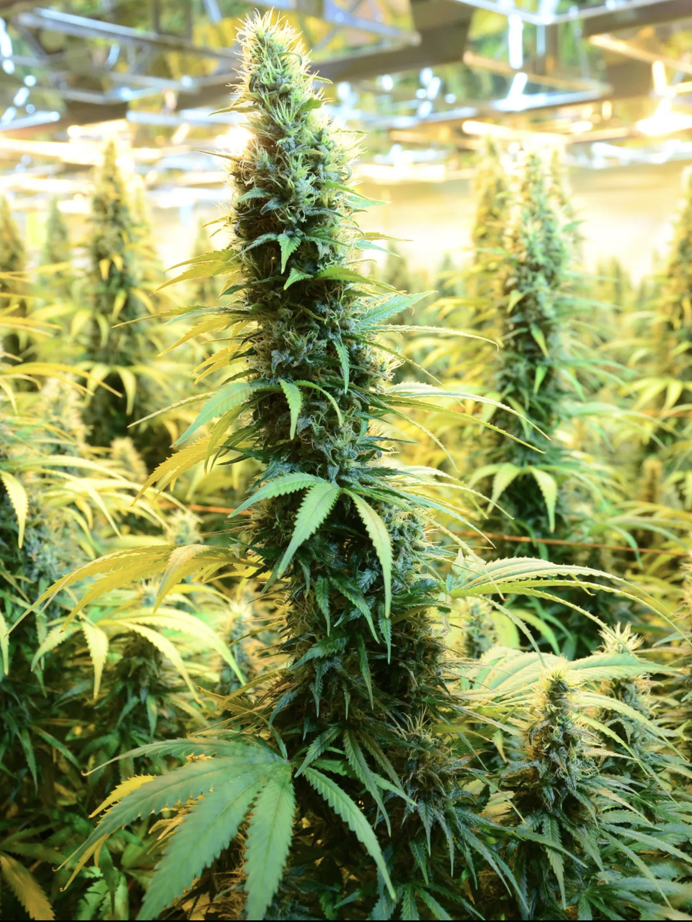
Cannabis: Overview
Cannabis Plant Contains:
Phytocannabinoids
  100+ naturally occurring chemical compounds produced by the cannabis plant that interact with the body’s endocannabinoid system
  Tetrahydrocannabinol (THC) and Cannabidiol (CBD) are the most well known
Terpenes
  Aromatic compounds found in cannabis that give each strain its distinct scent and flavor
  Have physiological effects, influencing mood, stress response, pain perception, and how phytocannabinoids interact with the ECS
Flavonoids (Cannaflavins)
  Plant-based antioxidant compounds found in cannabis, fruits, and vegetables that contribute to color, anti-inflammatory activity, and cellular protection

Slide 19
Cannabis: Phytocannabinoids
Over 100+ phytocannabinoids have been identified
  THC, CBD, CBN, CBG
Phytocannabinoids mimic or modulate the body’s own endocannabinoids
They interact with CB1 and CB2 receptors (and other signaling pathways)
  Influence ECS tone, neuronal adaptability, immune, inflammation, and stress responses
Think of phytocannabinoids as messages from plants that speak the language of our endocannabinoid system

Slide 20
Cannabis: Phytocannabinoids
Abbreviation | Full Name | Key Actions | Notable Effects
THC | Δ9-Tetrahydrocannabinol | Partial agonist at CB1 & CB2 | Psychoactive; analgesic; appetite stimulation; anti-nausea; sleep support
CBD | Cannabidiol | Modulates CB1 & CB2 (not direct activator) | Anti-anxiety; anti-inflammatory; reduces overactivation; promotes homeostasis
CBG | Cannabigerol | Precursor to many cannabinoids (the “mother cannabinoid”) | Anti-inflammatory; supports gut healing; neuroprotective
CBC | Cannabichromene | Interacts with TRPV1 and CB2 | Anti-inflammatory; mood support; may enhance effects of other cannabinoids
CBN | Cannabinol | Oxidation product of THC | Mildly sedating; may improve sleep; gentle muscle-relaxing effects
THCV | Tetrahydrocannabivarin | Partial agonist/antagonist at CB1 (dose-dependent) | Low doses = appetite/satiety support; can be focusing and energizing
CBDV | Cannabidivarin | Similar structure to CBD | Under study for seizure disorders and neurodevelopmental support
These are a few of the primary phytocannabinoids that interact with the ECS.
Some activate the ECS receptors directly, like THC.
Others, like CBD and CBG, modulate how the ECS receptors respond.
Together, they influence pain, inflammation, emotional regulation, gut function, metabolism, and resilience.

Slide 21
Cannabis: Terpenes
Aromatic compounds found in cannabis
Give each strain its distinct smell, flavor, and therapeutic personality
Interact with ECS and neurotransmitter systems
  Influencing mood, inflammation, pain perception, and stress response
Terpene | Aroma / Flavor | Therapeutic Notes | Found In
Myrcene | Earthy, musky, herbal | Sedating, muscle relaxing, increases cannabinoid absorption (“couch-lock”) | Hops, mango, lemongrass
Limonene | Citrus | Uplifting, mood-brightening, reduces stress signaling | Citrus peels, juniper
Pinene | Pine forest | Enhances alertness & memory; anti-inflammatory | Pine needles, rosemary, basil
Linalool | Lavender / floral | Calming, anxiolytic, supports sleep | Lavender, mint
Caryophyllene | Peppery, clove | Binds directly to CB2 - anti-inflammatory & gut-supportive | Black pepper, cloves, oregano

Slide 22
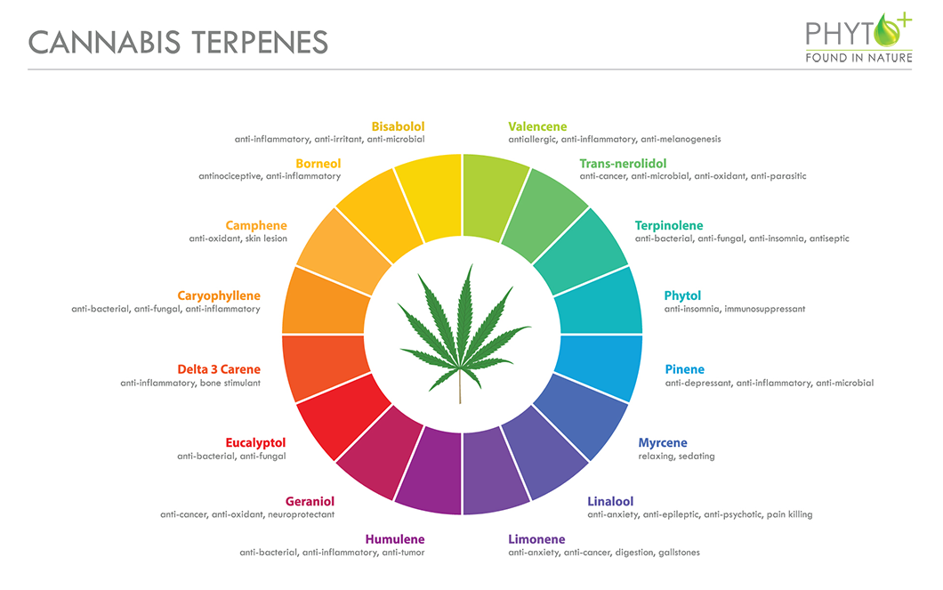
Cannabis: Terpenes

Slide 23
Cannabis: Flavonoids
Plant-based antioxidant compounds that contribute to the color, protection, and anti-inflammatory effects of cannabis
In cannabis, cannaflavins provide especially powerful anti-inflammatory activity
Protects tissues from oxidative stress and modulate inflammatory pathways
  Work alongside cannabinoids and terpenes to enhance therapeutic outcomes
Flavonoid | Notable Effects | Found In
Cannaflavin A | Potent anti-inflammatory (in some models stronger than NSAIDs) | Unique to cannabis
Quercetin | Antioxidant; mast cell stabilizer; supports vascular health | Berries, onions, cannabis
Kaempferol | Anti-inflammatory; supports brain and metabolic health | Kale, tea, cannabis
Apigenin | Calming; anxiolytic; supports GABA activity | Chamomile, parsley, cannabis

Slide 24
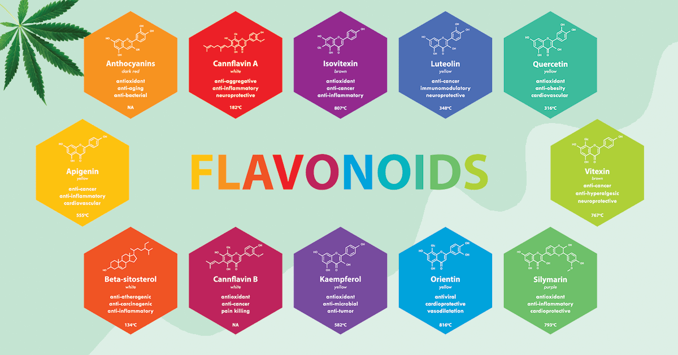
Cannabis: Flavonoids

Slide 25
Cannabis: Strains
Cannabis strains are selectively bred varieties of cannabis, each with a distinct chemical profile
Each strain has a unique concentration of cannabinoids, flavonoids, and terpenes
  Determines how it will taste and smell
  Determines therapeutic effects on the body*
700+ different strains of cannabis
Can have wild names:
  Pineapple express, Genius juice, Notorious THC, DNA cake, Maui Wowie

Slide 26
Cannabis: Classification
Category | General Reputation | Commonly Reported Effects
Indica | “In-da-couch” | Relaxing, grounding, calming, body-focused effects; evening use
Sativa | “Stimulating & Uplifting” | Energizing, mood-brightening, creative, daytime use
Hybrid | Blended genetics | Experience varies — depends on the strain’s chemical profile
OLD CLASSIFICATION
Strain names and Indica/Sativa tell us where the plant came from
Chemovar Type | Cannabinoid Profile | Therapeutic Emphasis
Type I | THC-dominant | Psychoactive; helpful for pain, mood, sleep, systemic inflammation
Type II | Balanced THC : CBD | Therapeutic with fewer cognitive effects; great for anxiety + pain
Type III | CBD-dominant | Non-intoxicating; supports inflammation, anxiety, recovery, gut health, modulate immune system
Chemovar classification tells us what the plant will do in the body
NEW CLASSIFICATION

Slide 27
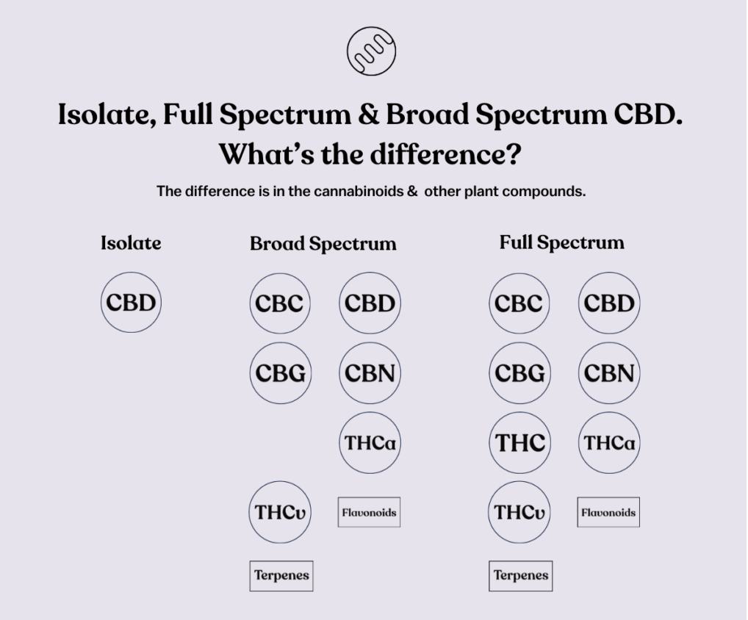
Cannabis: Extracts
Isolate
  Only CBD or THC cannabinoid extract
Broad Spectrum
  Contains all the plants’ cannabinoids EXCEPT THC
  Commonly associated CBD dominant products (Type III)
Full Spectrum
  Contains all the plants’ cannabinoids and other compounds such as terpenes and flavonoids
Isolate is one molecule.
Broad spectrum is the plant minus THC.
Full spectrum is the plant as nature made it.

Slide 28
Cannabis: Entourage Effect
Entourage effect is the synergistic interaction between phytocannabinoids, terpenes, and flavonoids
  Their combined effects are greater than any single compound alone
These compounds work together potentially creating what is known as the "entourage effect”
  Combined effects of cannabis's diverse compounds
  Enhance the overall properties of cannabis
  Influencing its therapeutic effectiveness and modifying its psychoactive impacts
Whole food supplementation concept

Slide 29
Cannabis: Entourage Effect
Whole-plant extracts → more therapeutic than isolated THC or CBD
Terpenes shape the psychoactive and therapeutic profile
CBD can modulate THC psychoactive effects
Flavonoids (Cannaflavins) add anti-inflammatory power beyond cannabinoids alone

Slide 30
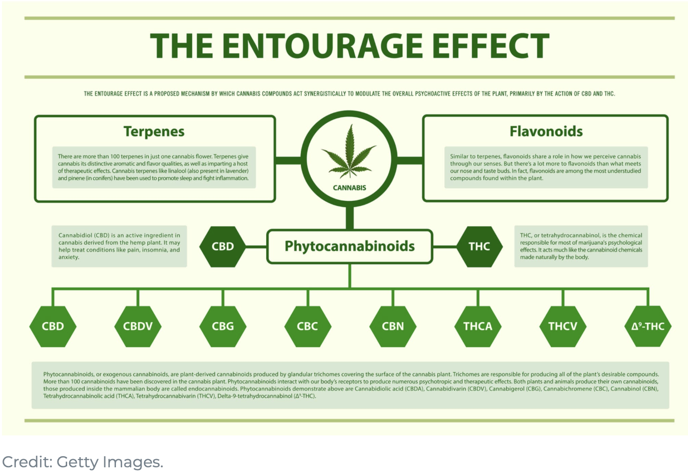
Cannabis: Entourage Effect

Slide 31
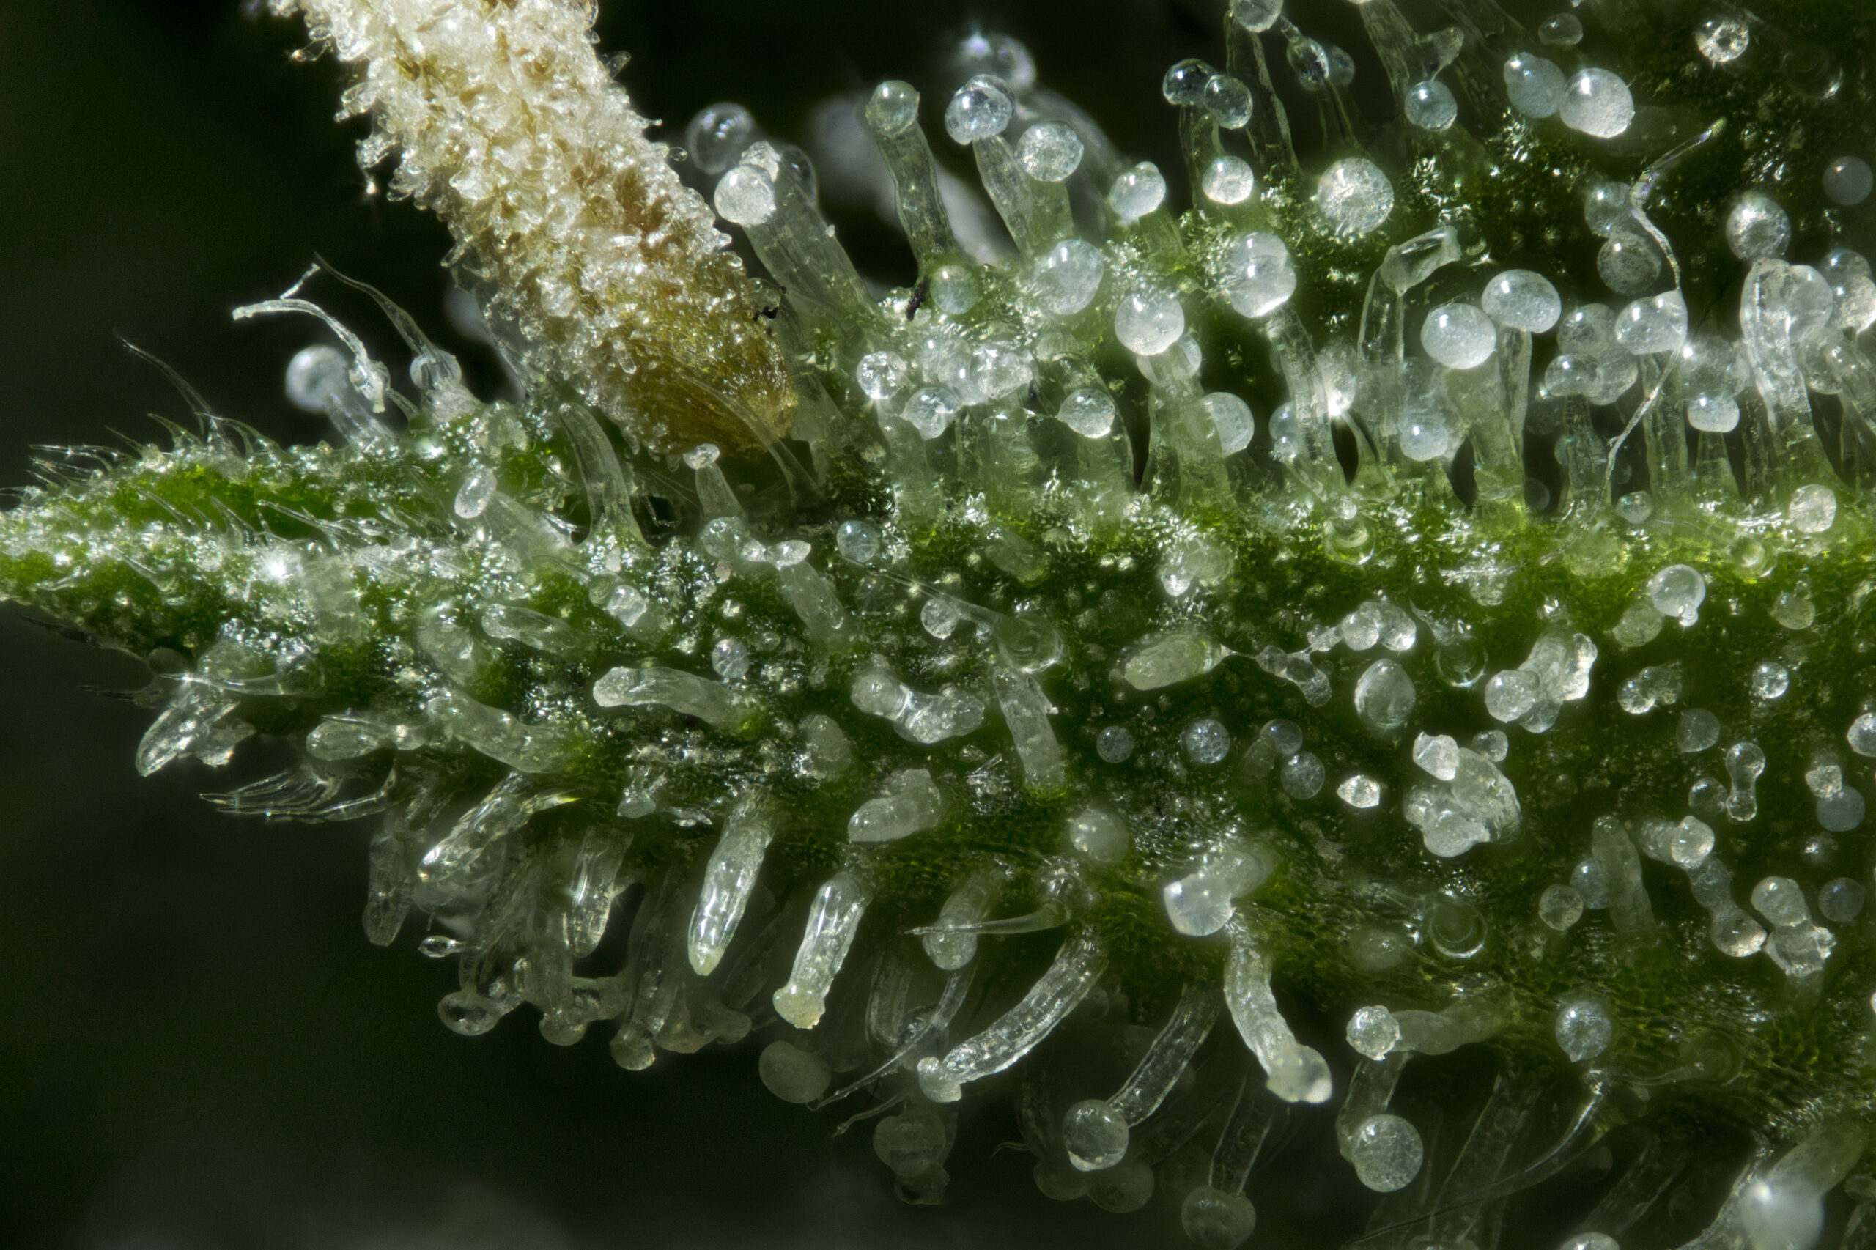
Cannabis: Therapeutic Application
FIRST, WHAT IS YOUR DESIRED OUTCOME OR INTENTION:
  Reduce inflammation / pain?
  Modulate immune system?
  Chill out? Sleep better?
SECOND, FIGURE OUT THESE OPTIONS:
1. Administration route
2. Isolate, broad / full spectrum product
  Strain / Chemovar
  Entourage effect
3. Dosage ratio and overall dosage

Slide 32
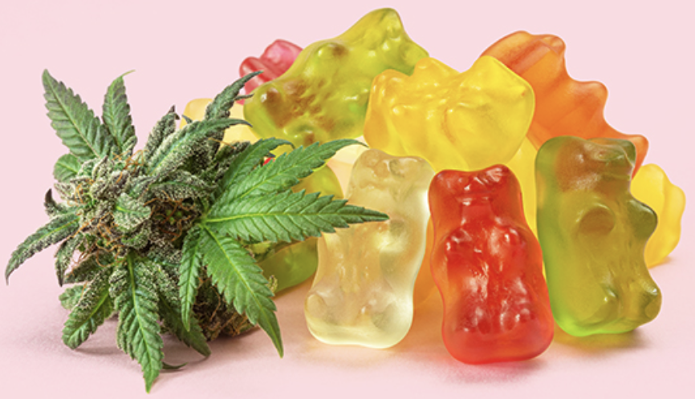
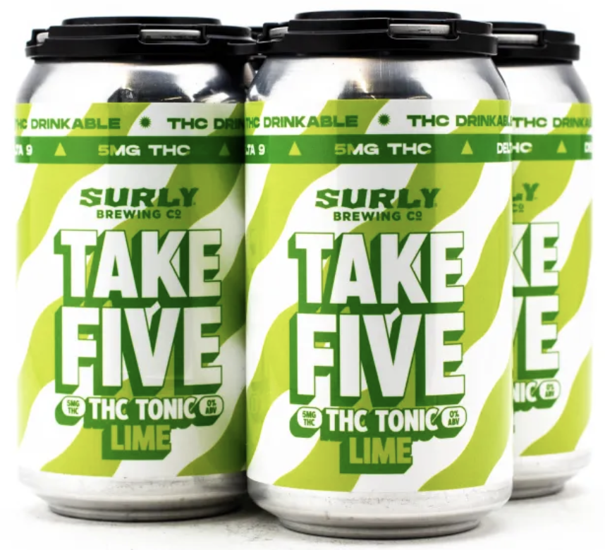
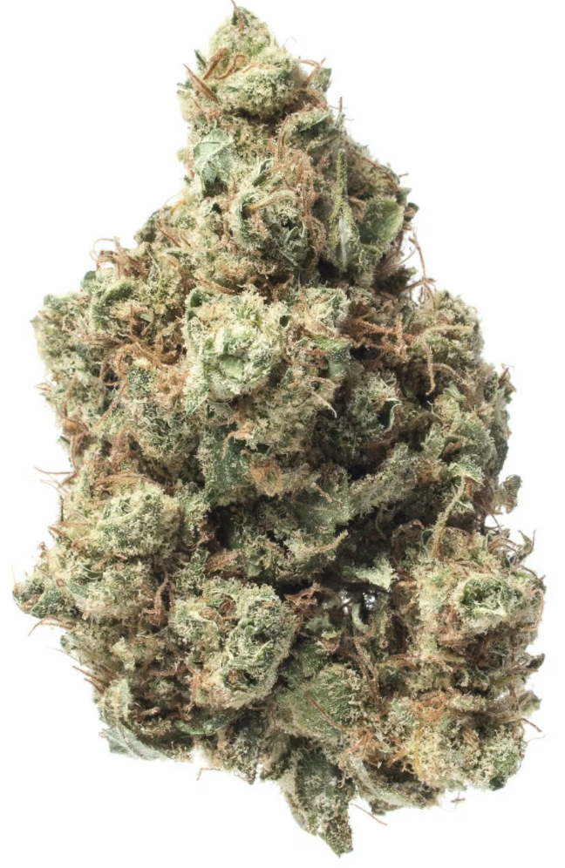
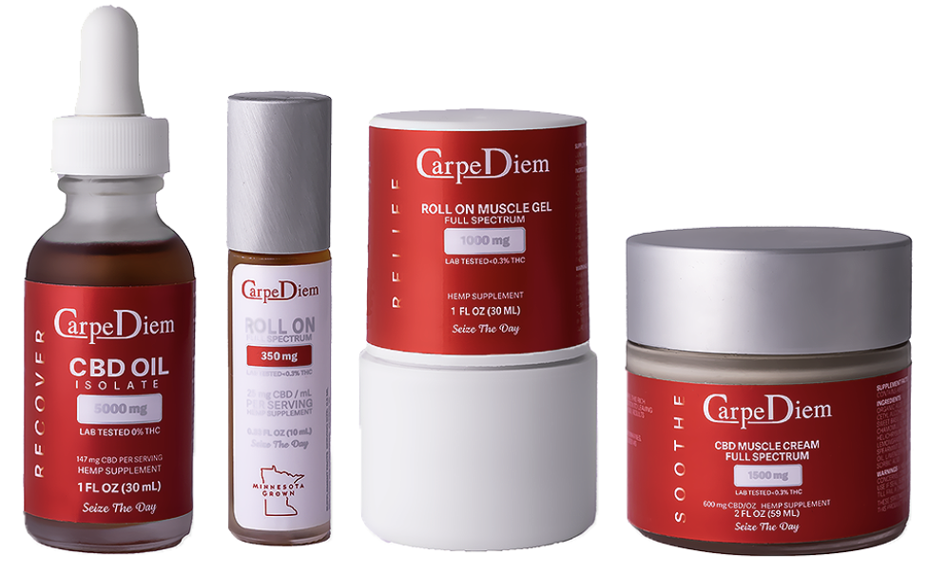
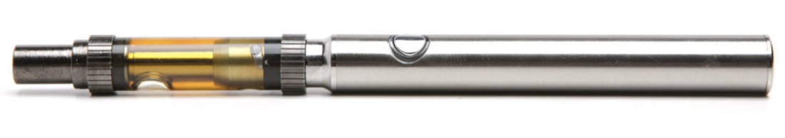
Cannabis: Therapeutic- Route
Dried Plant
  Smoking and vaporizing
Sublingual / Tinctures
Oral Ingestion
  Edibles
  Drinks
Topical
  Creams
  Roll-ons
  Sprays
The onset of effects varies depending on the method of administration
**Not an endorsement any of these products

Slide 33
Cannabis: Therapeutic- Classification
Isolate vs Broad Spectrum vs Full Spectrum
Type I vs Type II vs Type III OR Strain of Cannabis
This is where it gets confusing- both are still used
KEY: What is your desired outcome or intention?
  Identify the Chemovar
  Identify the strain
  If limited choices on strain- try to utilize full or broad spectrum

Slide 34
Cannabis: Therapeutic- Dosage Ratio
The key is the ratio of CBD : THC and absorbability of the product
  Can be taken through various administration routes
  Big difference between oral/respiratory vs topical administration
How to understand the ratios…
  Difference between a 1:1 and 5:1 to a 1:10 ratio?
  Ratio of 1:1 means that there is as much CBD as THC in the product
  Ratio of 5:1 means there is 5x as much CBD as THC
  Ratio of 1:10 means there is 10x as much THC as CBD
Dosage is key too!
  A 1:1 ratio of 50 mg of CBD to 50 mg of THC is not the same potency as a 10 mg of CBD to 10 mg of THC

Slide 35
Clinical Use: Analgesic- Topical
Diversity of topical administration
  Creams or roll-ons
Cannabinoids (THC and CBD) can be absorbable through the skin
  Do not enter the bloodstream*
Mechanism | Needs Support | Who Does That?
Inflammation in the joint capsule | CB2 activation | CBD + other non-THC cannabinoids
Pain sensitivity at the nerve ending | CB1 & TRPV1 modulation | THC + CBD together
Do you want isolate or full spectrum? What classification: Type I, II, or III?

Slide 36
Clinical Use: Analgesic- Internal
Diversity of administration ways
  Edibles and respiratory
Phytocannabinoids enter systemic circulation and act upon CB1 and CB2 receptors throughout the CNS, PNS, immune system and other organs
Internal Analgesic Effects
↓ Pain signal intensity
↓ Inflammatory source of pain
↓ Stress amplification of pain
System | Target Receptor | Pain Mechanism Affected
Central Nervous System | CB1 | Reduces pain perception + decreases pain chatter in the brain
Peripheral Tissues & Immune System | CB2 | Reduces inflammation that drives pain
Brain–Body Stress Circuits | 5-HT1A, TRPV1, PPAR pathways | Reduces emotional amplification of pain (anxiety around pain)

Slide 37
Clinical Use: Analgesic- Internal
Type II is usually the best first-line choice for systemic pain
  THC reduces the brain’s interpretation of pain
  CBD reduces the body’s generation of pain
Pain Presentation | Best Chemovar | Why
Inflammatory Pain Arthritis, autoimmune, fibromyalgia | Type II | CBD reduces inflammation THC reduces pain perception
Neuropathic Pain Nerve pain, burning, post-surgery | Type I (THC-dominant) | CB1 activation is key for nerve pain modulation
Chronic Tension + Stress Pain Headache, TMJ, muscle guarding | Type II or low-dose Type I | THC relaxes CNS tone + CBD reduces stress reactivity
Patients Sensitive to THC | Type III | Supports inflammation / emotional modulation

Slide 38
Clinical Use: Analgesic- Internal
Usage Considerations and Recommendations
Type of Pain: Choice of ratio often depends on the type of pain
  For inflammatory and autoimmune related pain- Type III
  For neuropathic or severe pain- Type I or Type II
Personal Sensitivity: Individual reactions to THC can vary greatly
Start Low and Slow: Particularly for ratios involving higher levels of THC

Slide 39
Questions
Questions?

