Slide 1
2026 South Dakota
Kenneth Finn, MD

Slide 2
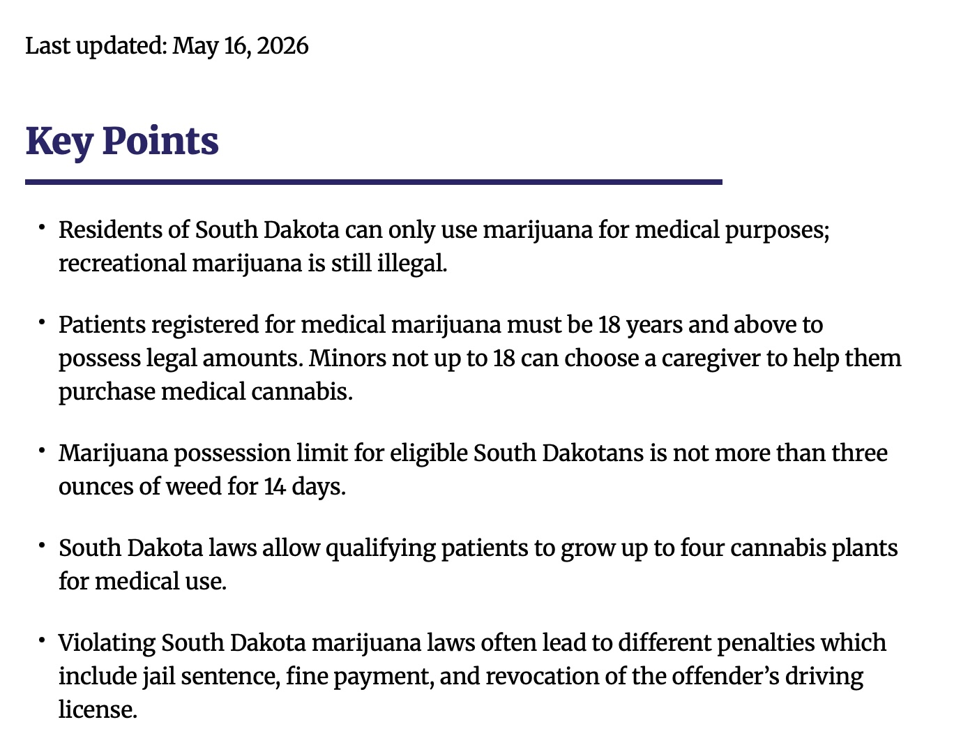

Slide 3
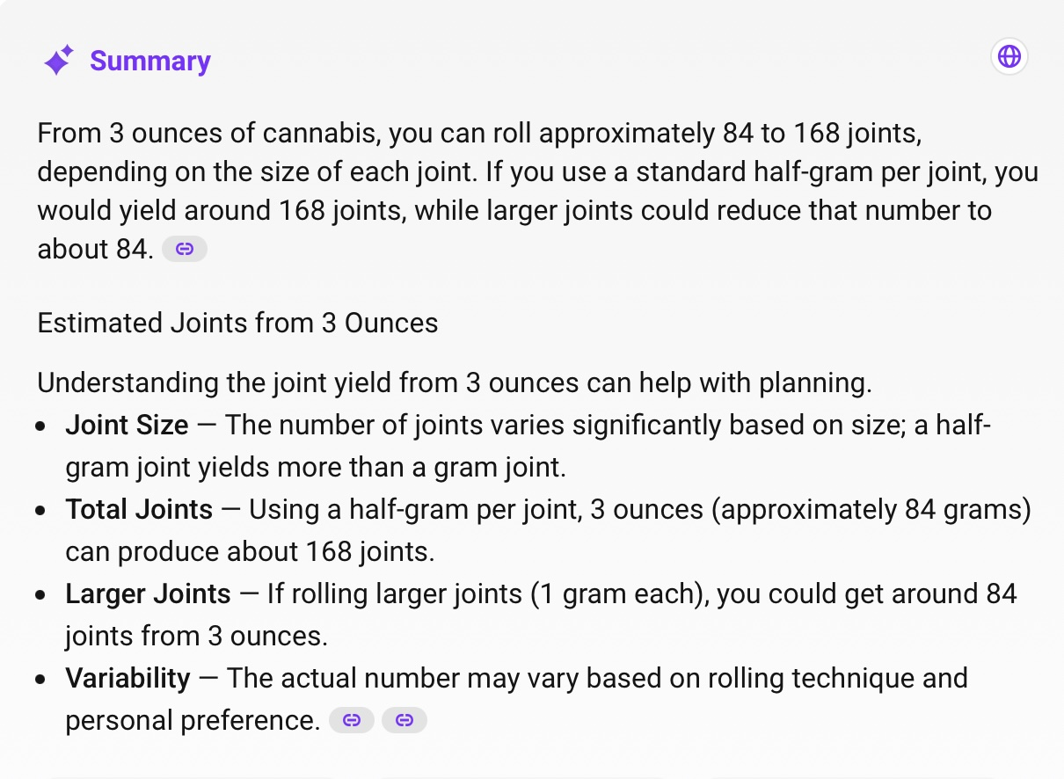
12 joints per day

Slide 4
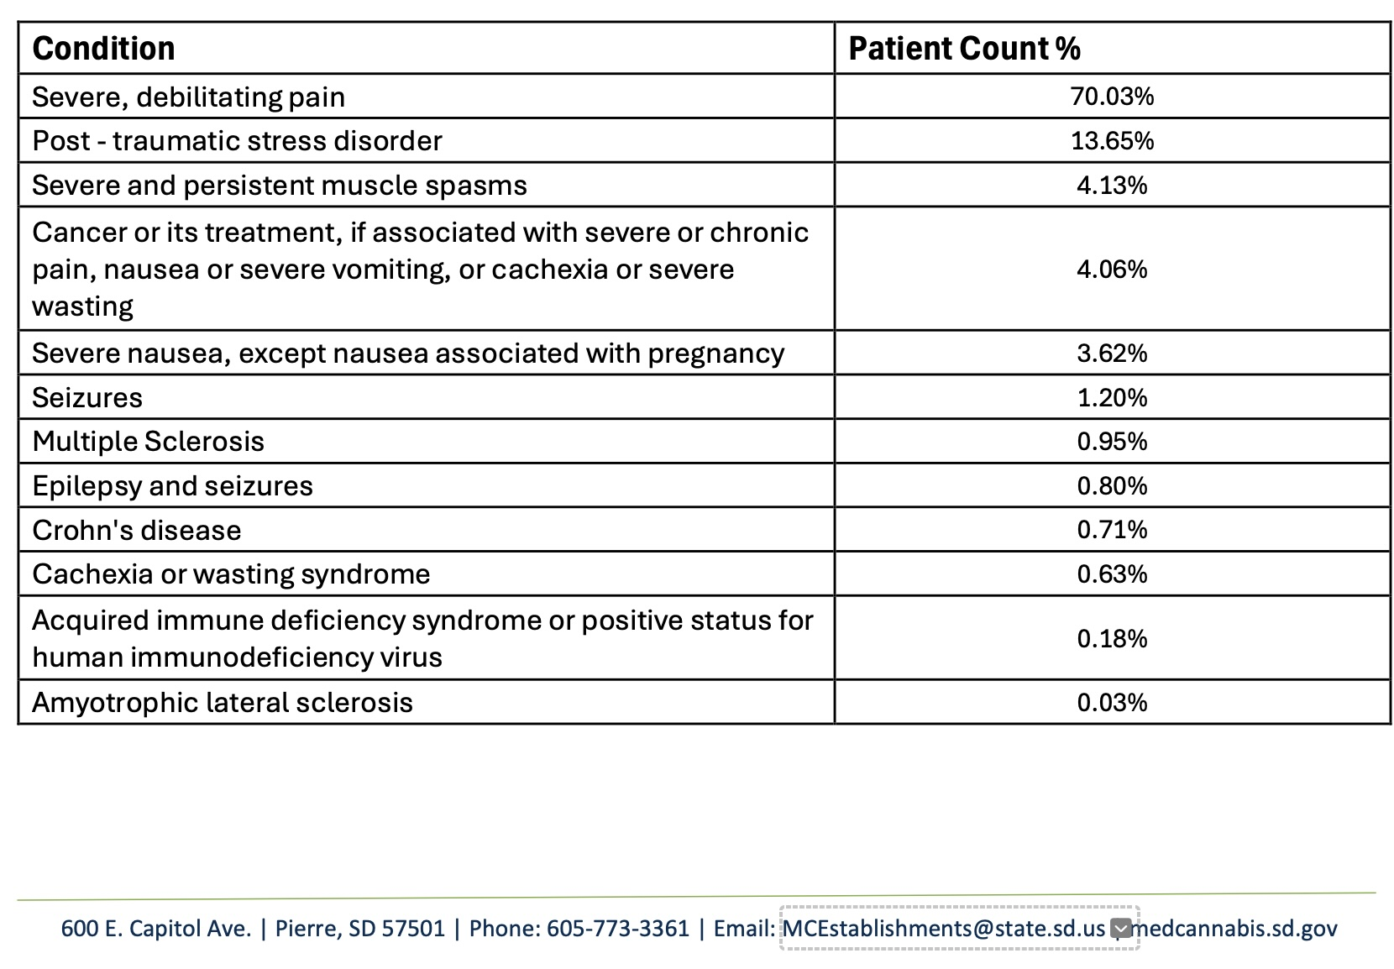

Slide 5
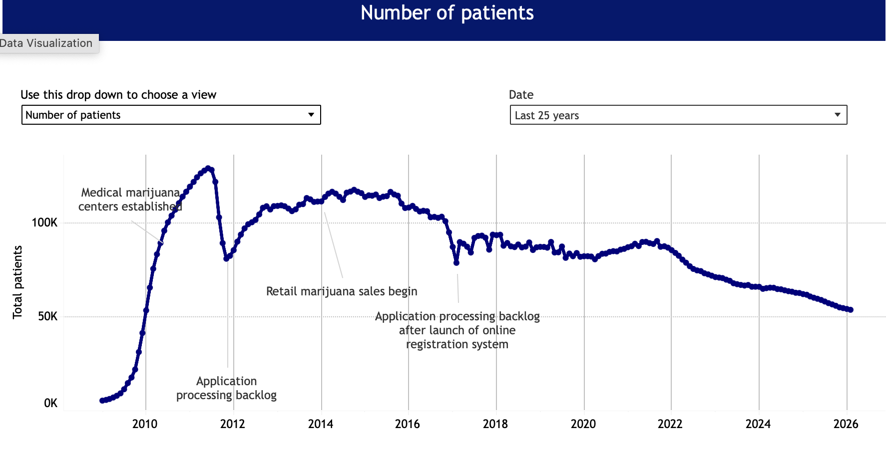
https://cdphe.colorado.gov/medical-marijuana-registry-data

Slide 6
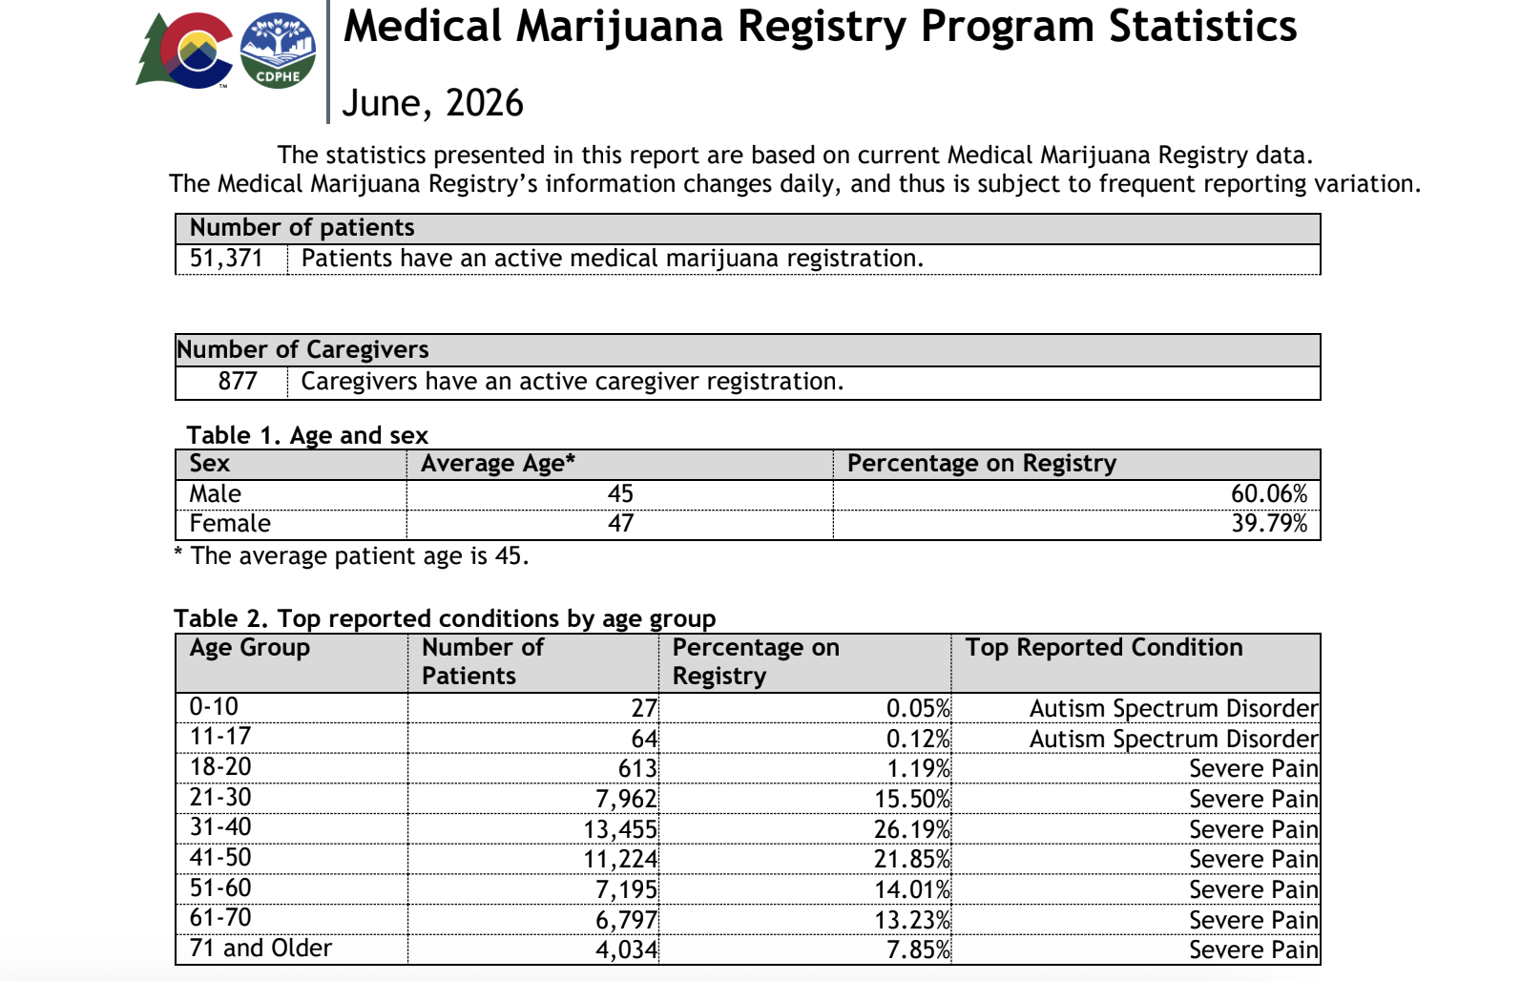
https://drive.google.com/file/d/1yaSwaihpBPJ46SGoJBJMXMKAVjvUDMkj/view

Slide 7
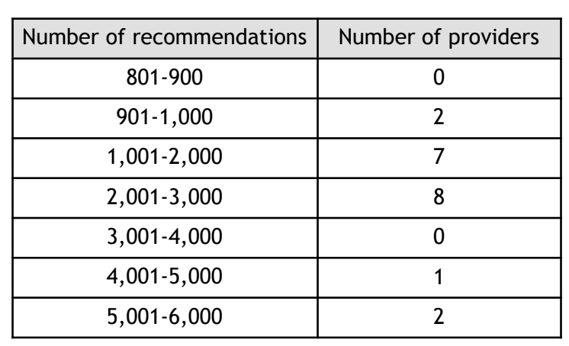
Medical Marijuana CO
January 2026; CO Legislative Report
3 providers made 20% of all recommendations (one patient every 20 minutes)
https://drive.google.com/file/d/1Zkj9m7xat0Ic8CoGb0lftlUVOJQCEnVg/view

Slide 8
Medical marijuana oversight bill advances after Spotlight PA investigations reveal doctor concerns, 2025
https://www.spotlightpa.org/news/2025/03/pennsylvania-medical-marijuana-program-doctor-oversight/

Slide 9
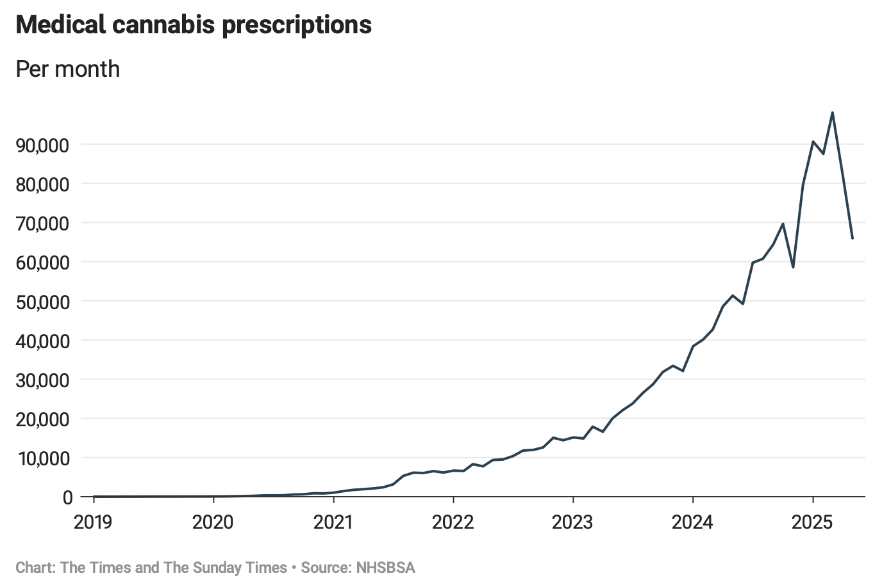
Ten doctors have prescribed half of all cannabis drugs: UK
The Royal College of Psychiatrists says there is insufficient evidence to support treating mental health conditions with cannabis and warns that it may exacerbate disorders such as depression and psychosis
In 2020, there were fewer than 400 cannabis medications dispensed every month. By the first five months of last year, this had increased to 85,000 items a month.
https://www.thetimes.com/uk/healthcare/article/doctor-prescription-medical-cannabis-fvljnldqr

Slide 10
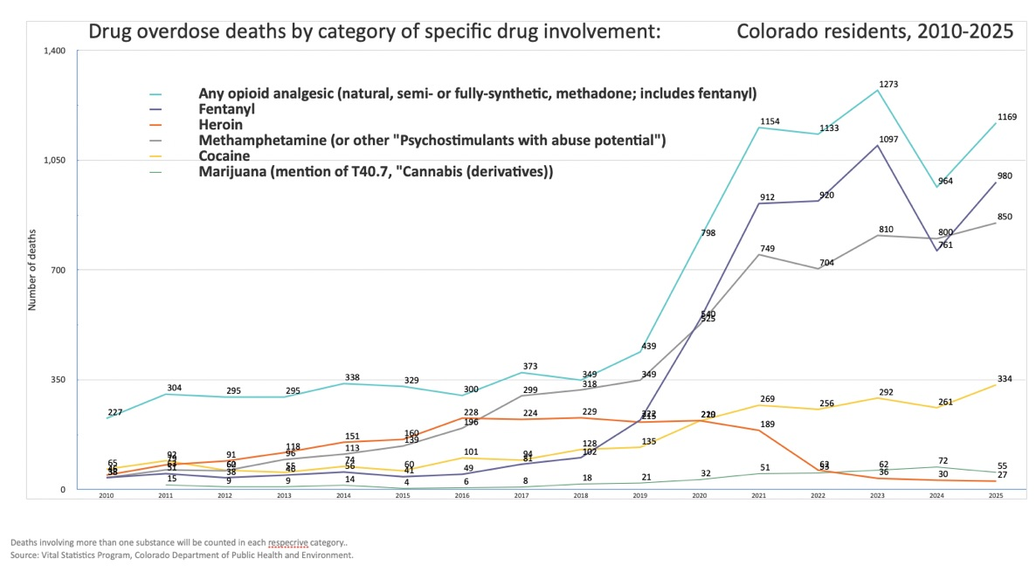

Slide 11
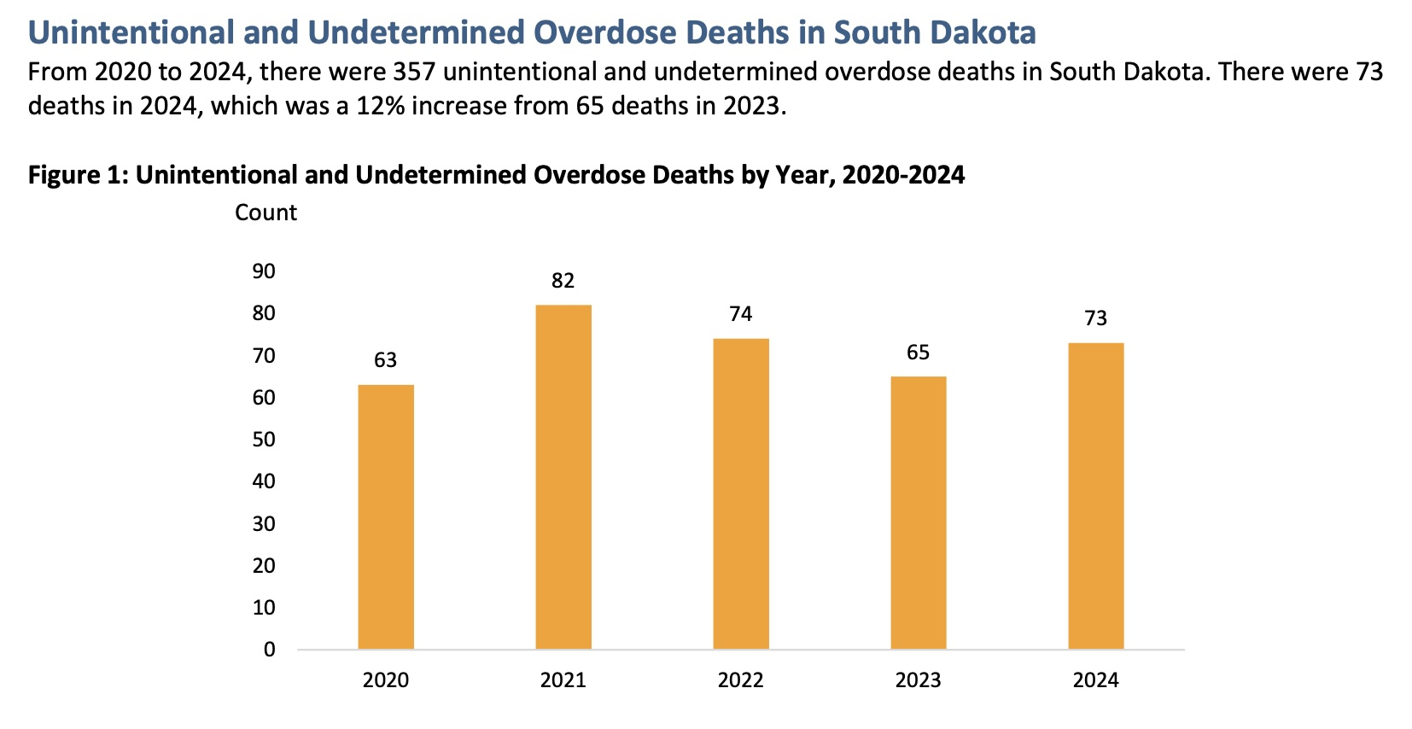

Slide 12
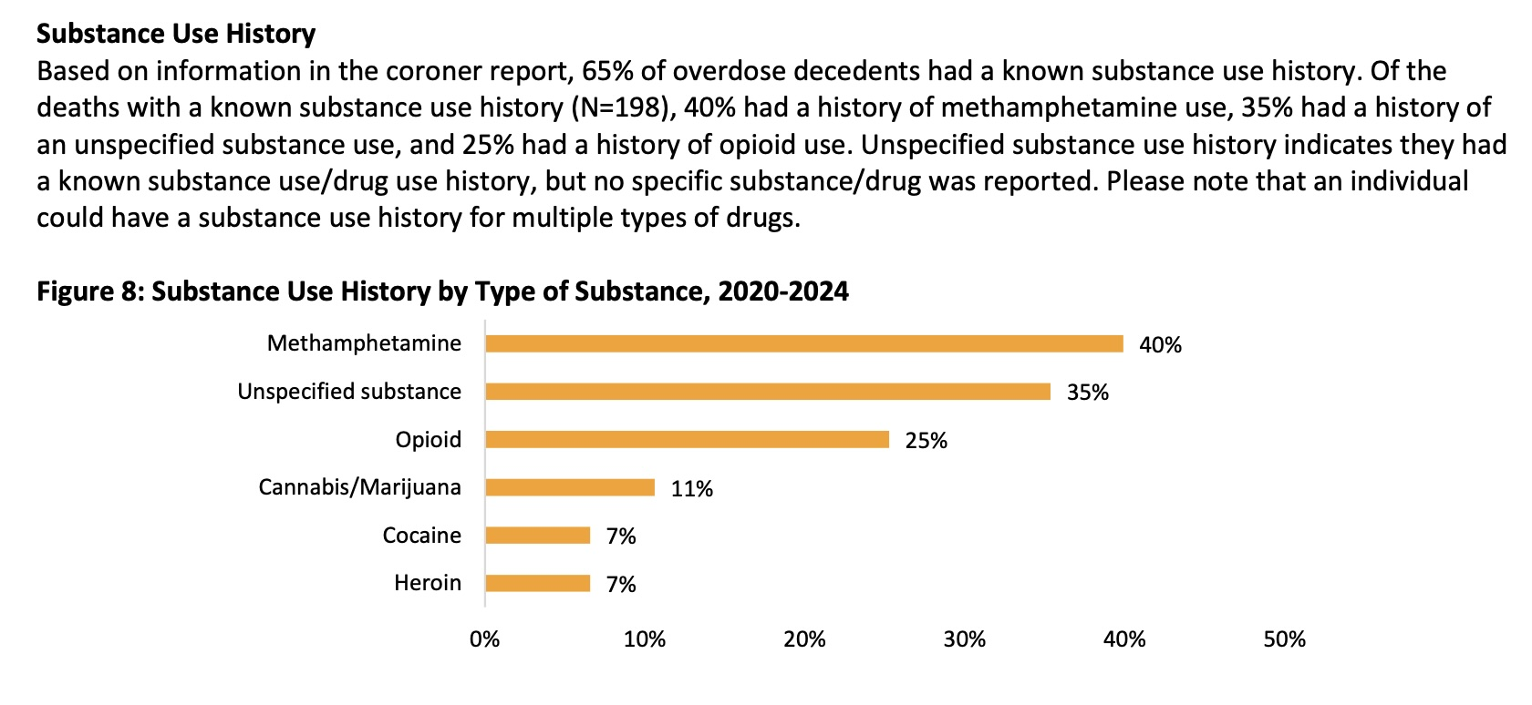

Slide 13
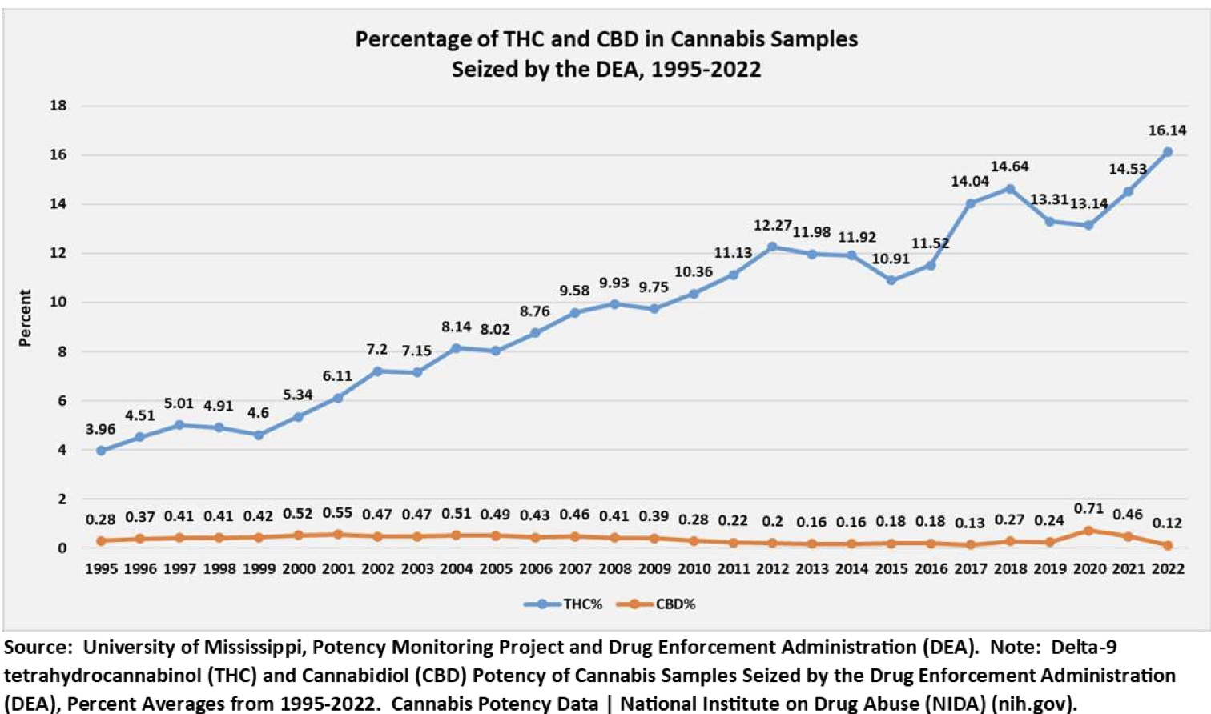
Potency/Product Integrity

Slide 14
High-Concentration Delta-9-Tetrahydrocannabinol Cannabis Products and Mental Health Outcomes: A Systematic Review
August 2025; Ann Int Med
High-concentration THC defined as greater than 5 mg or greater than 10% THC per serving or labeled as“high-potency concentrate,” “shatter,”or “dab.”
High-concentration THC products are associated with unfavorable mental health outcomes, particularly for psychosis or schizophrenia and CUD
https://www.acpjournals.org/doi/10.7326/ANNALS-24-03819

Slide 15
Changes in psychosis-related emergency department and hospitalization rates among youth following cannabis legalization in Colorado
August 2025; Drug and Alcohol Dependence
Psychosis-related hospitalizations rose in Colorado after cannabis legalization.
Rates of psychosis hospitalizations were observed among all age groups
Psychosis encounters with a cannabis diagnosis increased significantly after legalization.
https://www.sciencedirect.com/science/article/abs/pii/S0376871625001723

Slide 16
Age-dependent association of cannabis use with risk of psychotic disorder
May 2024; Psychological Medicine
N = 11,363
Adolescent/teen use has 11x risk of developing psychosis
5 out of 6 teens with psychotic symptoms used cannabis
Strength of association during adolescence was notably greater than in previous studies, possibly reflecting the recent rise in cannabis potency.
https://www.cambridge.org/core/services/aop-cambridge-core/content/view/BDCA0F73CDD7AF150D6FDCF89D29DC7F/S0033291724000990a.pdf/age-dependent-association-of-cannabis-use-with-risk-of-psychotic-disorder.pdf

Slide 17
  Cannabis Psychosis
February 2025; JAMA Open
Changes in Incident Schizophrenia Diagnoses Associated With Cannabis Use Disorder After Cannabis Legalization in Canada
The proportion of incident cases of schizophrenia associated with CUD almost tripled during a period of substantial liberalization of cannabis policy
https://pmc.ncbi.nlm.nih.gov/articles/PMC11795325/

Slide 18
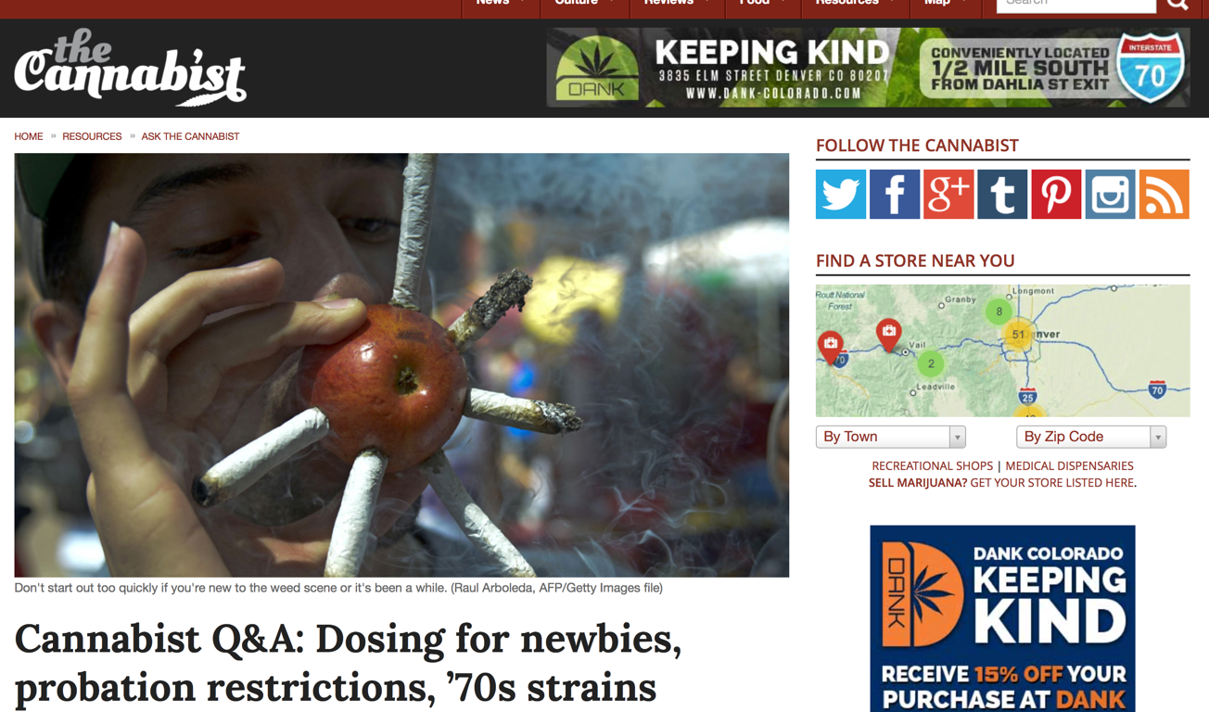
Cannabis Dosing?
http://www.thecannabist.co/2014/09/03/cannabist-q-a-marijuana-dosing-newbies-medical-marijuana-probation-restrictions-70s-strains/18308/

Slide 19
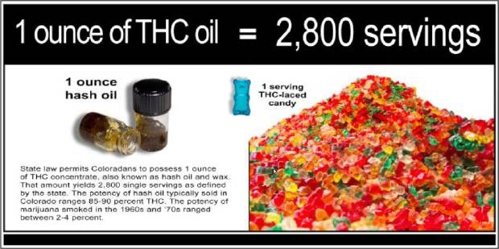
One ounce = one ounce in Colorado

Slide 20
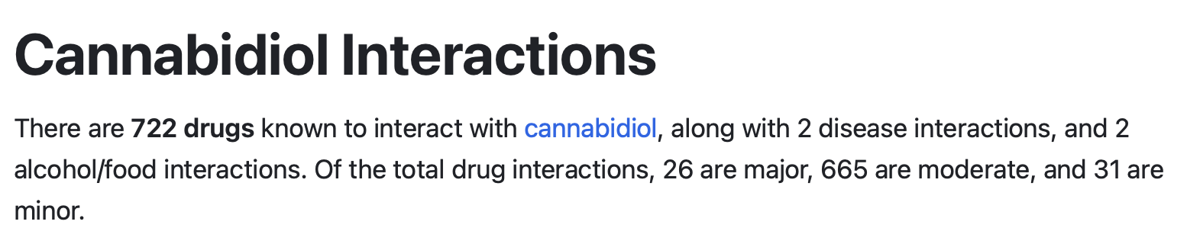
https://www.drugs.com/drug-interactions/cannabidiol.html

Slide 22
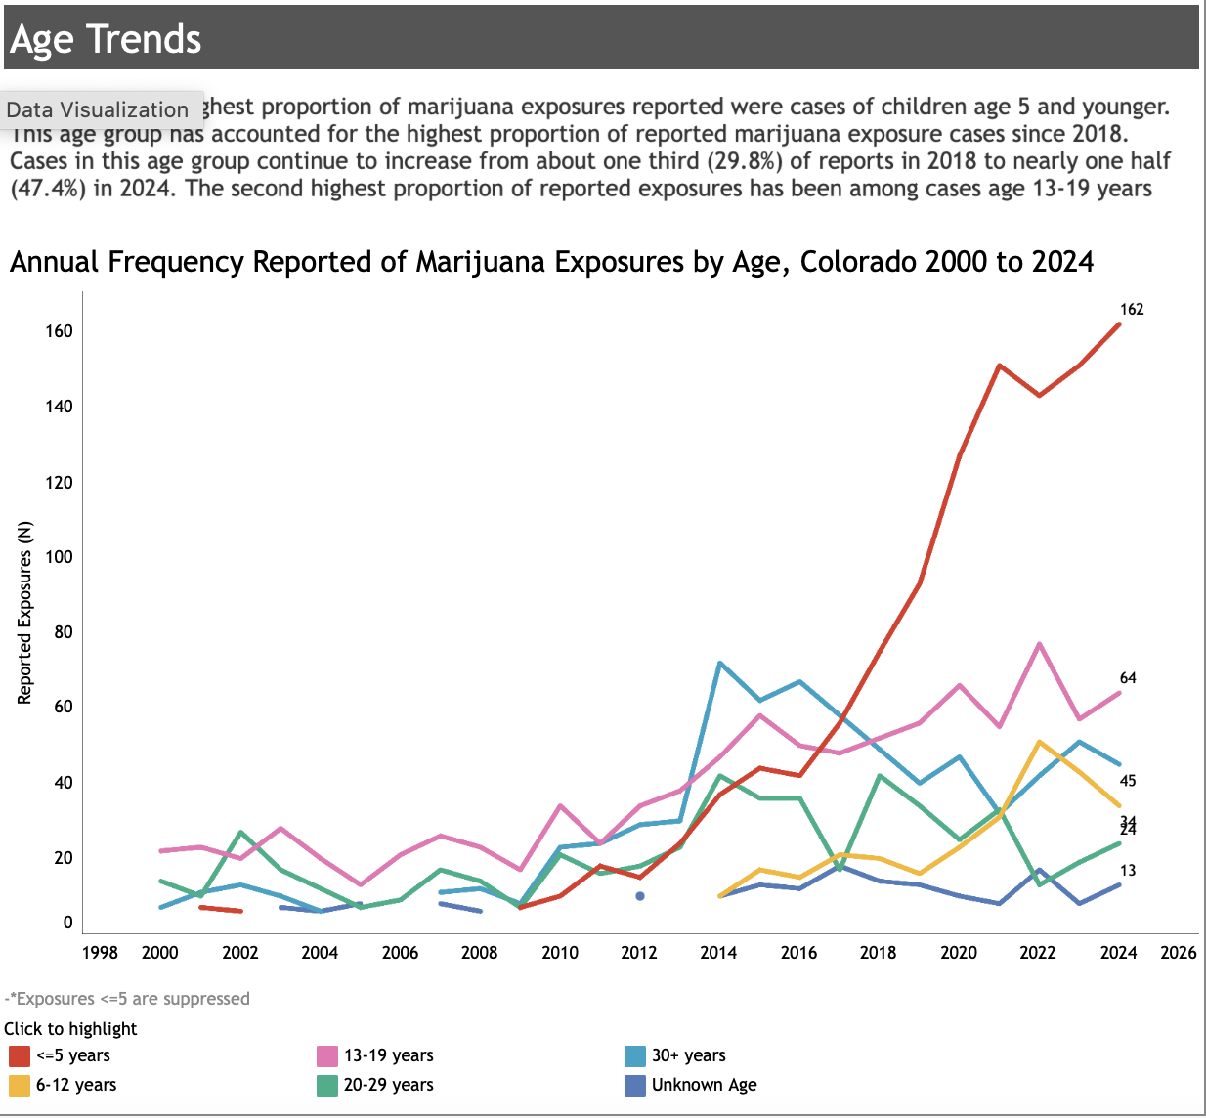
https://marijuanahealthinfo.colorado.gov/health-data/poison-center-data

Slide 23
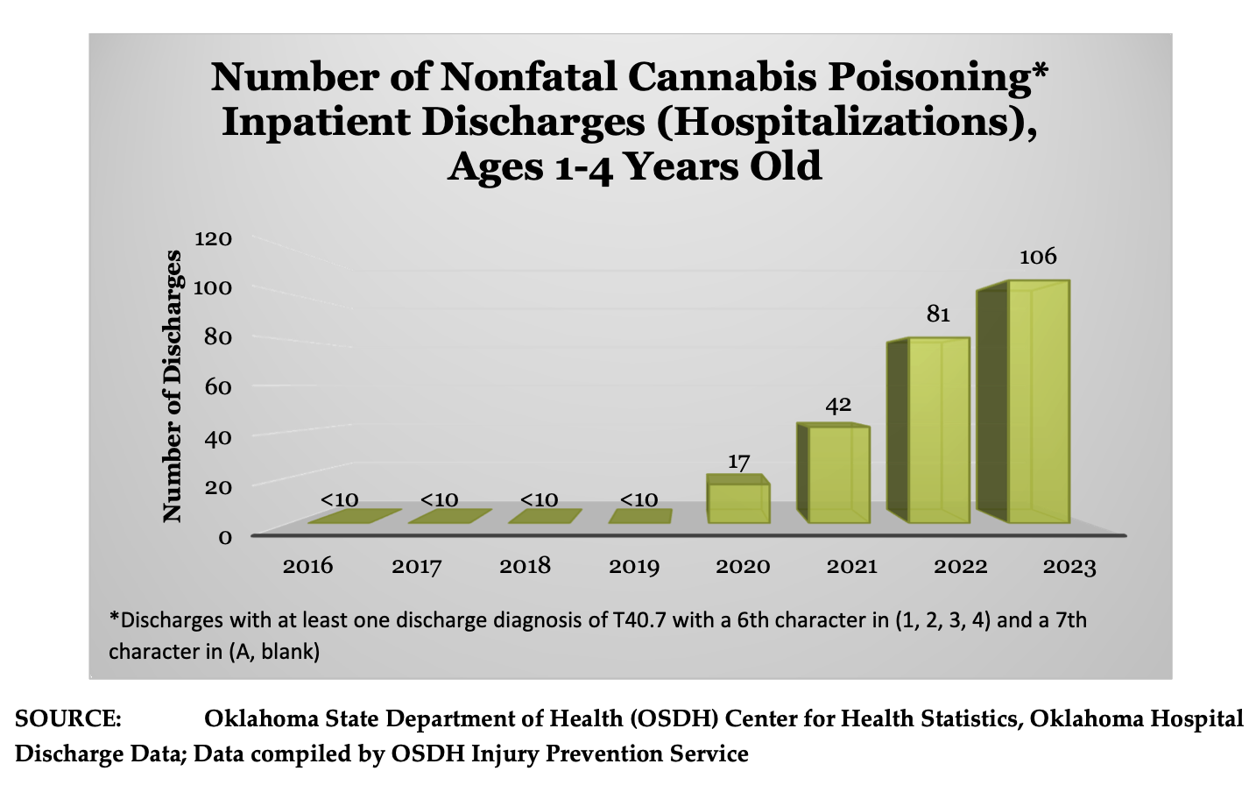
https://www.texomahidta.org/files/DDF/Texoma HIDTA Oklahoma Marijuana Report 2025.pdf

Slide 24
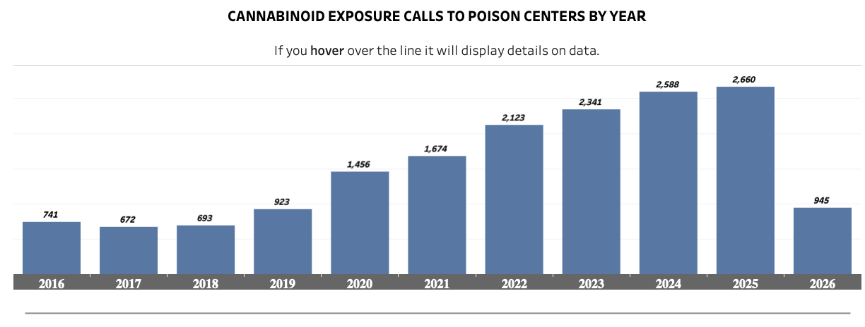
THC Poisonings in Texas Have Tripled Since Hemp Legalization
marijuana/THC poison-control calls climbing from 923 in 2019 to 2,592 in 2024
Indicating a 300% increase in 5 years
calls involving children five and under rose 495% from 2017 to 2022
https://healthdata.dshs.texas.gov/dashboard/drugs-and-alcohol/poison-center-calls/Cannabinoid-related-poison-center-calls

Slide 25
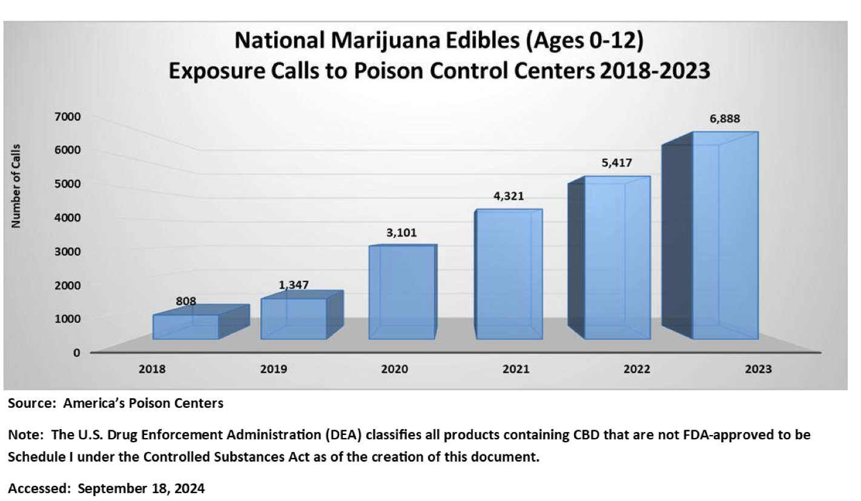

Slide 26
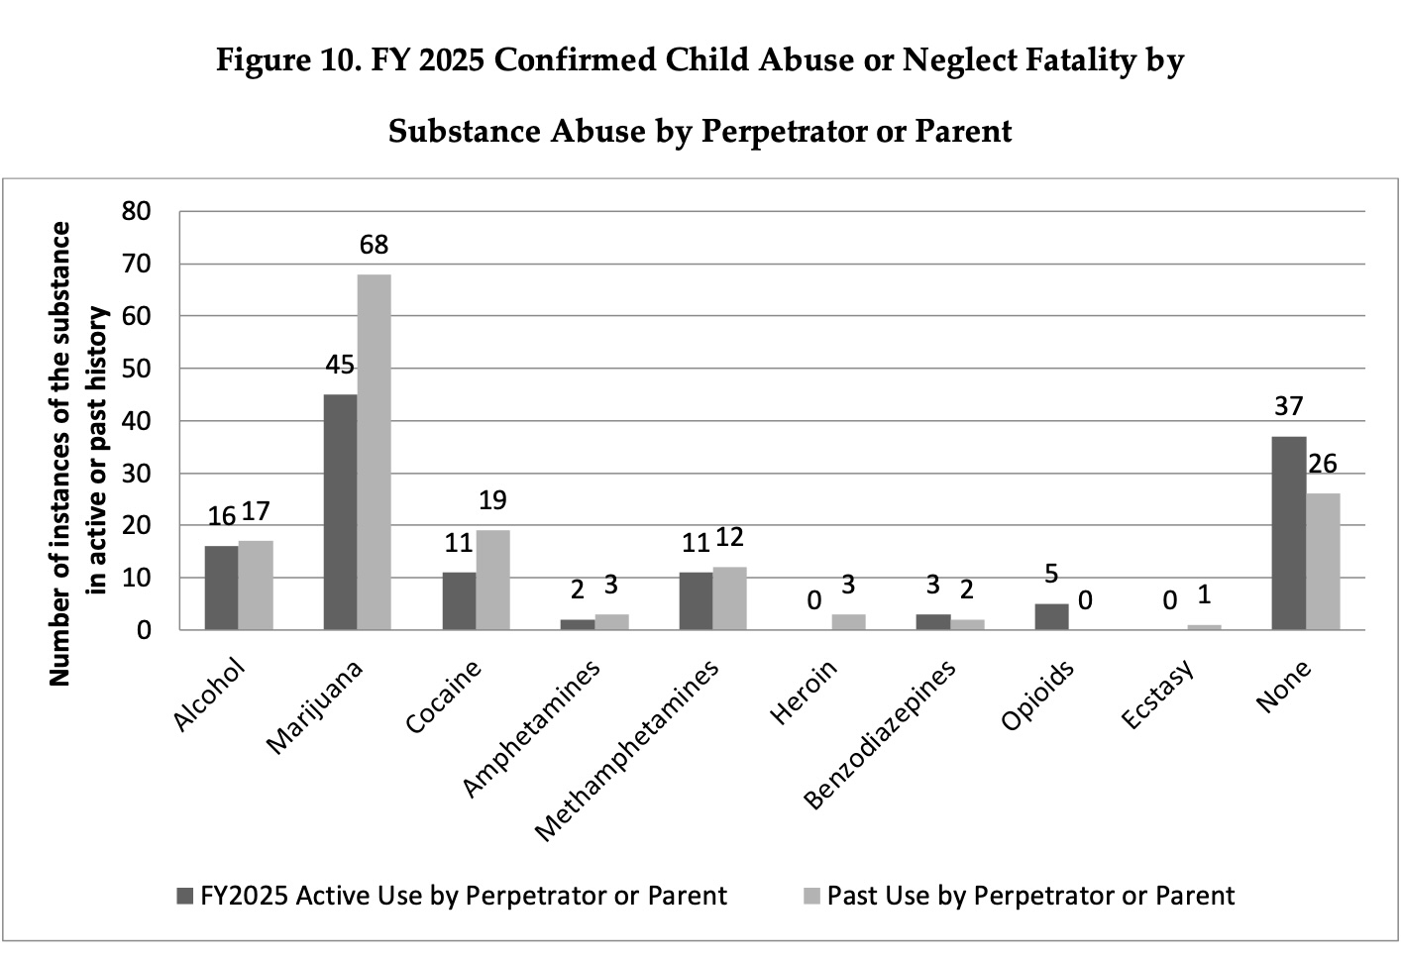

Slide 27
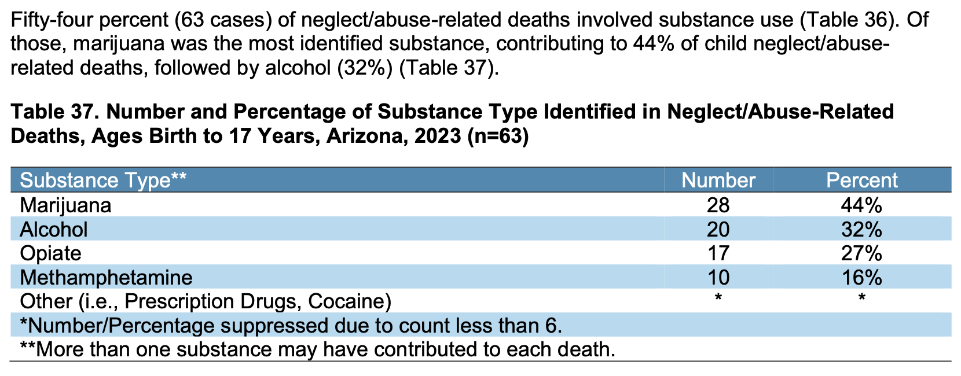
https://www.azdhs.gov/documents/prevention/womens-childrens-health/reports-fact-sheets/child-fatality-review-annual-reports/cfr-annual-report-2024.pdf

Slide 28
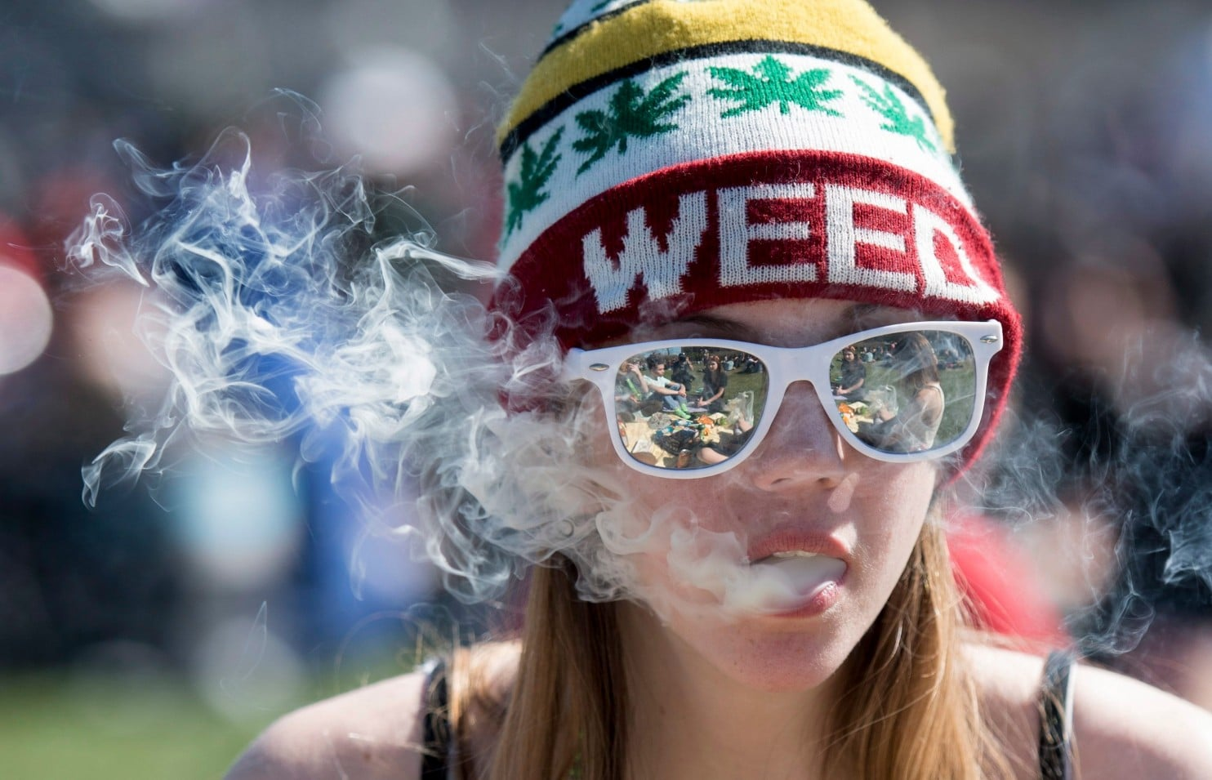

Slide 29
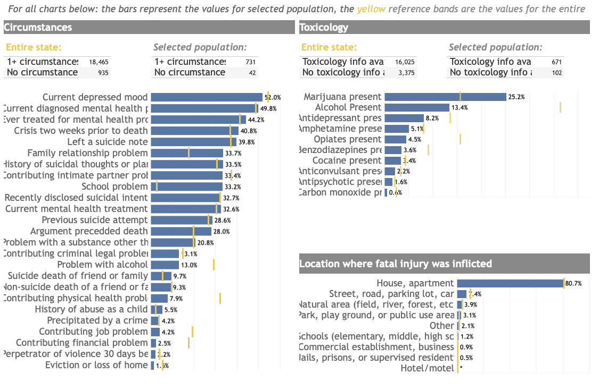
https://cohealthviz.dphe.state.co.us/t/HealthInformaticsPublic/views/COVDRSSuicideDashboardAllYearsExcludesRace/Story1?:embed=y&:iid=1&:isGuestRedirectFromVizportal=y

Slide 30
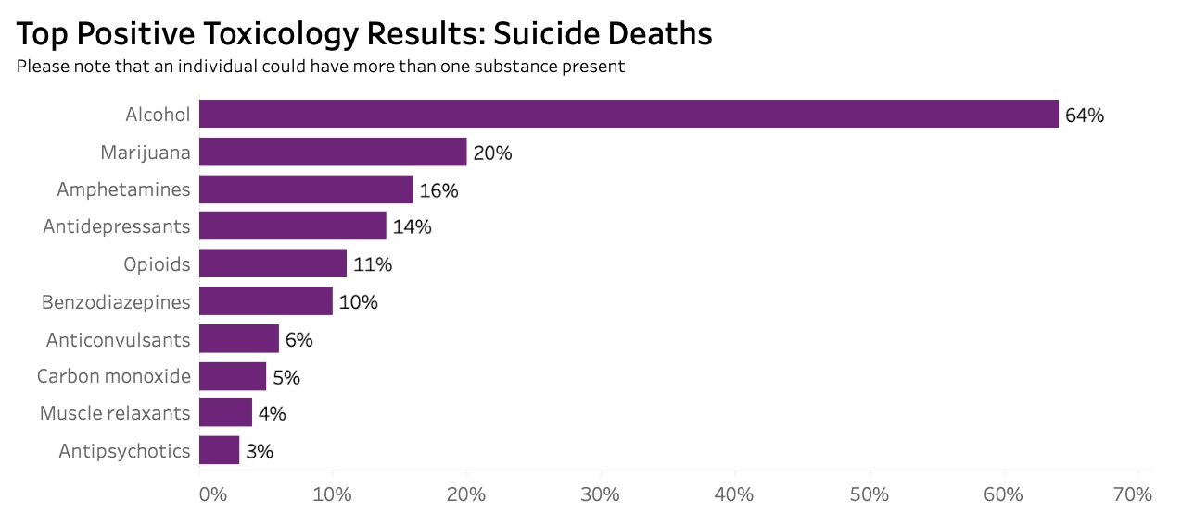

Slide 31
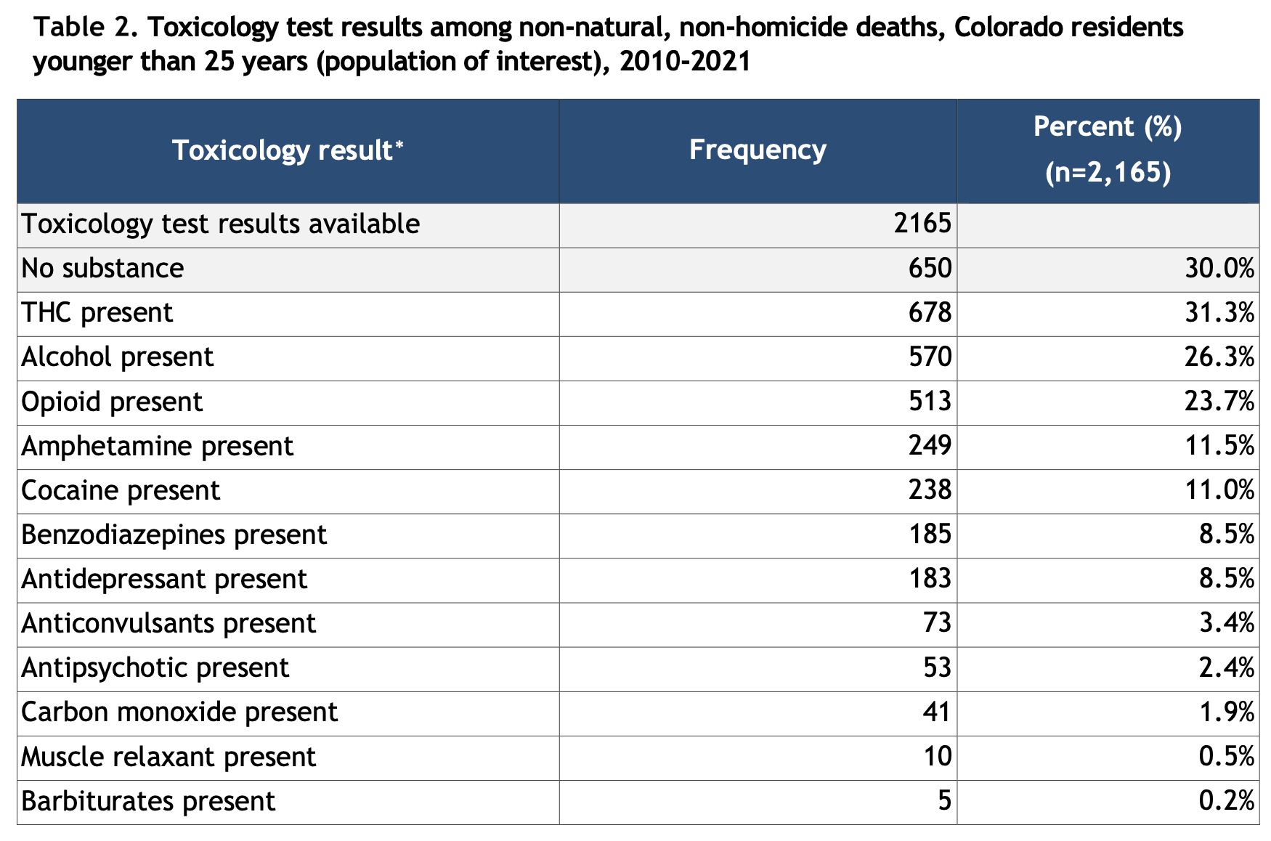
https://drive.google.com/drive/u/0/folders/1K0jYw-3spzb6F3OTOw1JLupdMK4Z5mfH

Slide 32
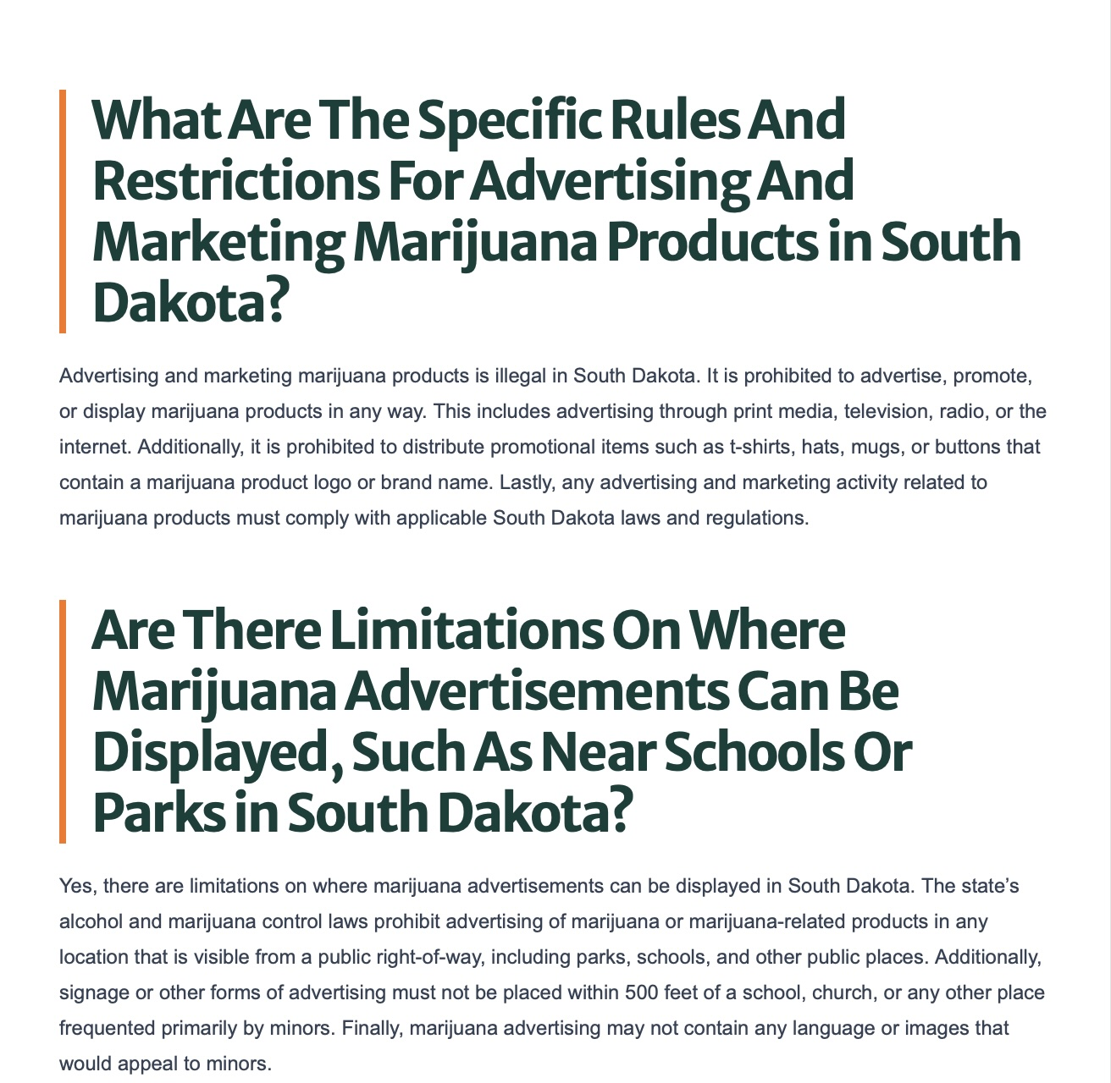

Slide 33
https://www.ftc.gov/news-events/news/press-releases/2024/07/ftc-fda-send-second-set-cease-desist-letters-companies-selling-products-containing-delta-8-thc

Slide 34
Exposure to cannabis advertising and its
association with cannabis use and intentions
February 2026; Addiction
General cannabis advertising (3 studies) exposure was statistically significantly associated with cannabis use
Internet/social media advertising (5 studies) also showed a statistically significant association
https://onlinelibrary.wiley.com/doi/10.1111/add.70310

Slide 35
How Cannabis Advertising and Price-Based Sales Promotion Shape Early Use: A National Study of Adolescents and Young Adults
May 2026; T&F Online
Exposure to any advertising was positively associated with initiation
When exposure was measured by number of advertising channels, exposure through one channel and three or more channels were significantly associated with higher initiation risk
https://www.tandfonline.com/doi/full/10.1080/10826084.2026.2670629

Slide 36
A Narrative Review of Research on Cannabis Advertising in the United States
December 2025; Current Addiction Reports
Cannabis marketing tactics may be appealing to youth or mislead consumers via unsubstantiated health claims
Cannabis is marketed in a variety of ways, including via tactics (e.g., price promotions) found to be effective in increasing use of other commercial products (e.g., tobacco)
Several studies have found associations between exposure to cannabis marketing and cannabis use
https://link.springer.com/article/10.1007/s40429-025-00703-1

Slide 37
Non-disordered Cannabis Use Among US Adolescents
May 3, 2023; JAMA
  Nondisordered cannabis use in adolesents (non-CUD, subclinical)
  Past-year NDCU was approximately 4 times as prevalent as past-year CUD
  Individuals with NDCU had approximately 2 to 4 times greater odds of ALL adverse psychosocial events examined, including major depression, suicidal ideation, slower thoughts, difficulty concentrating, truancy, low grade point average, arrest, fighting, and aggression
https://jamanetwork.com/journals/jamanetworkopen/fullarticle/2804450

Slide 38
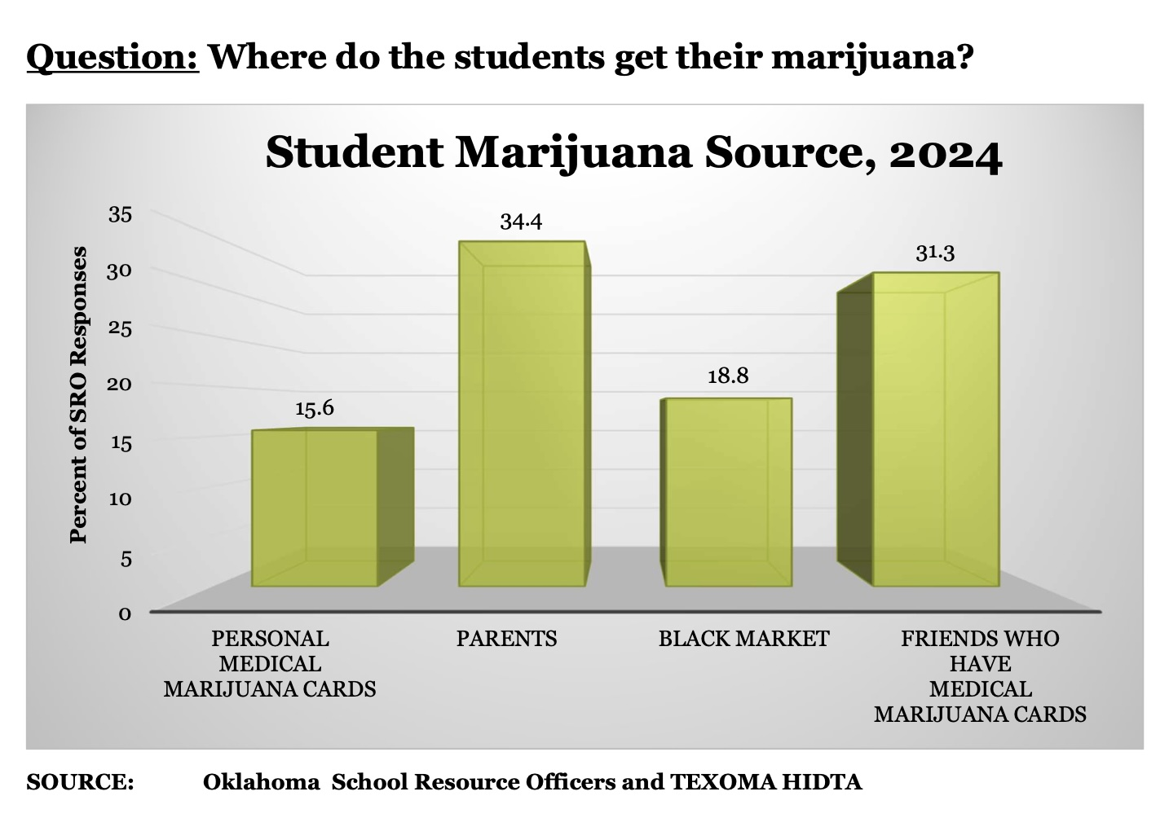

Slide 39
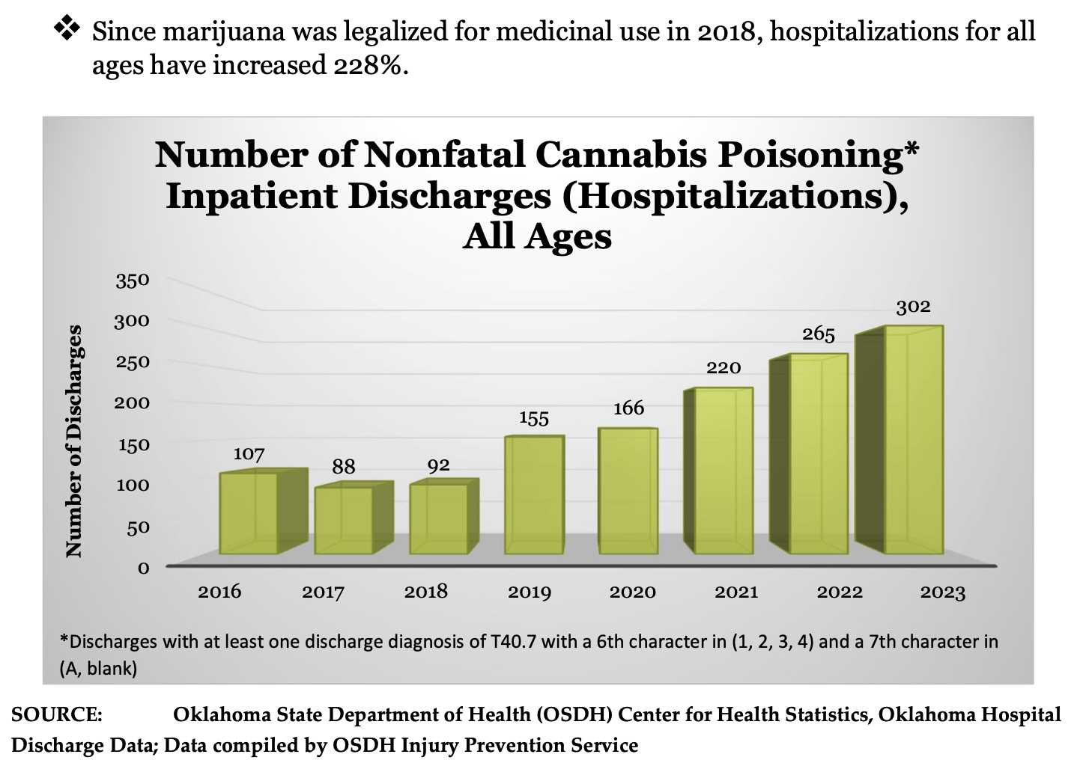

Slide 40
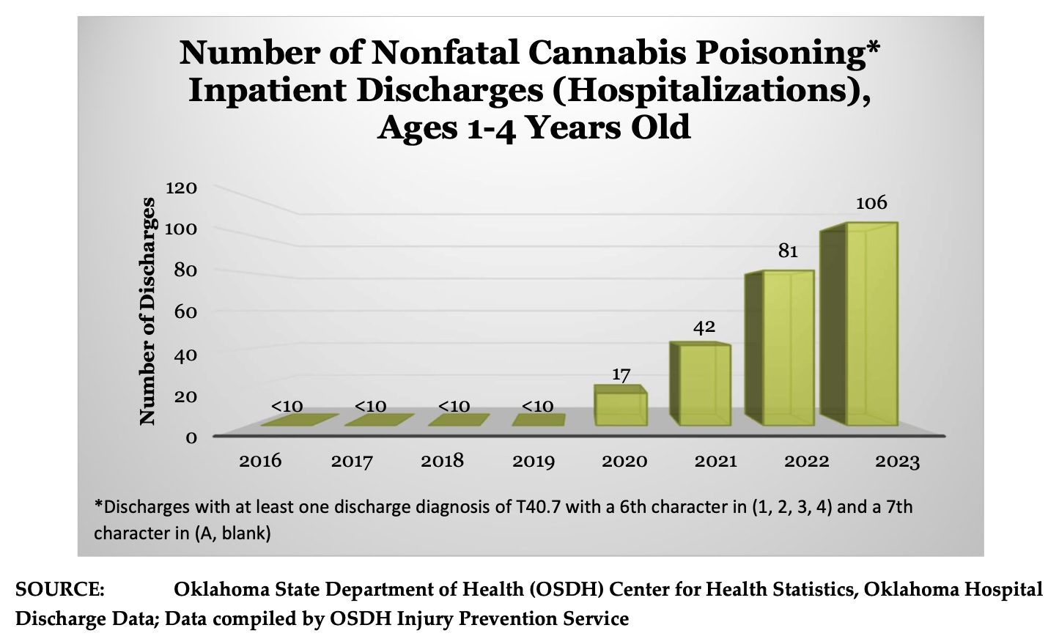

Slide 41
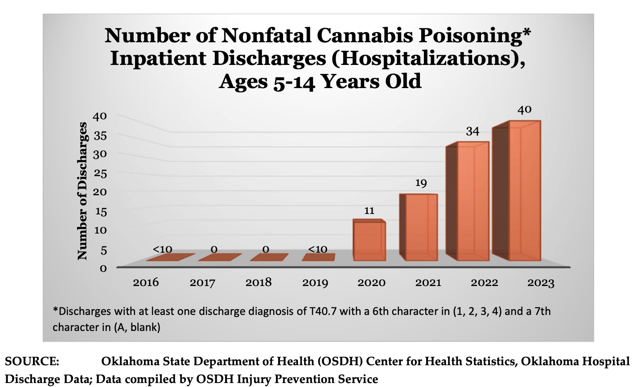

Slide 42
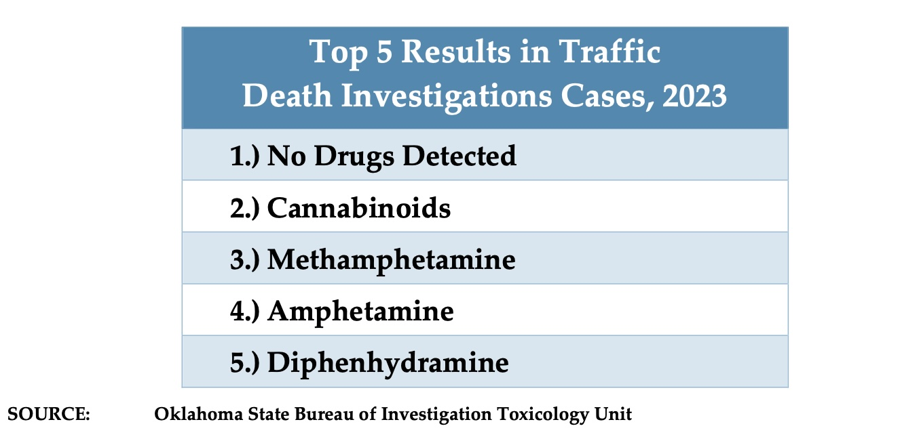

Slide 43
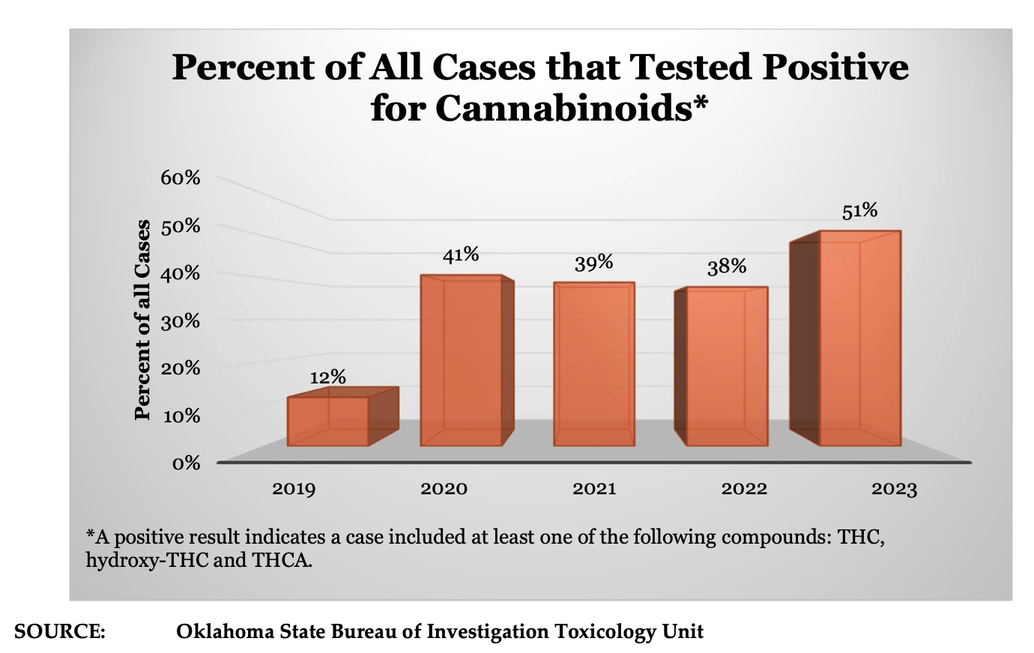

Slide 44
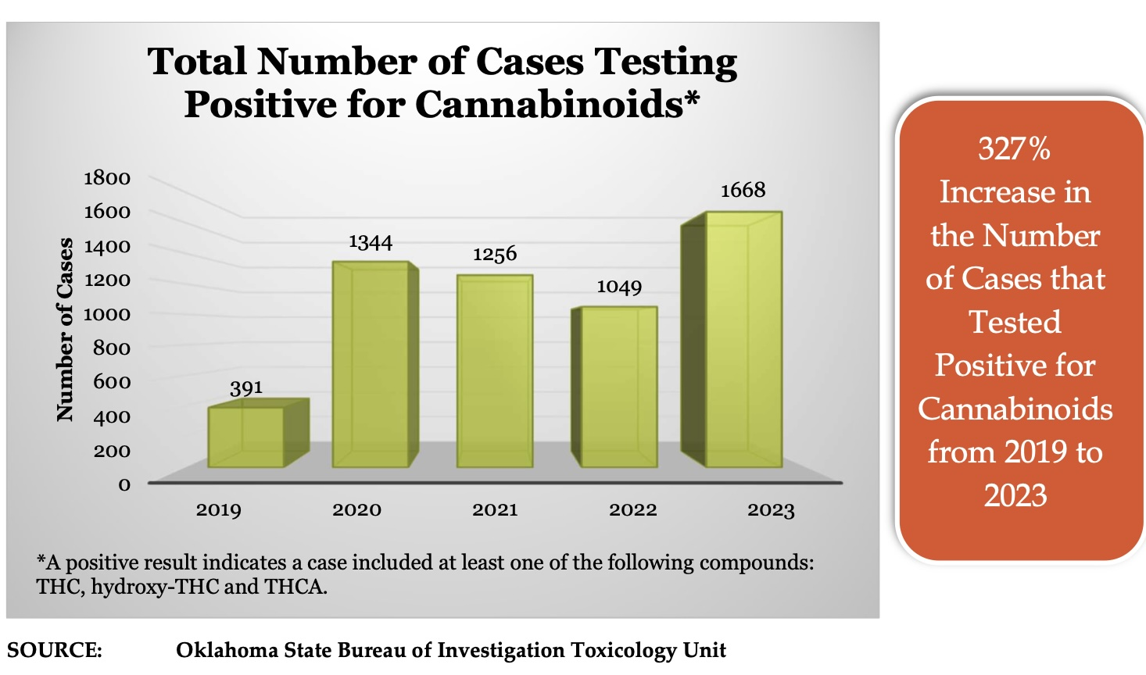

Slide 45
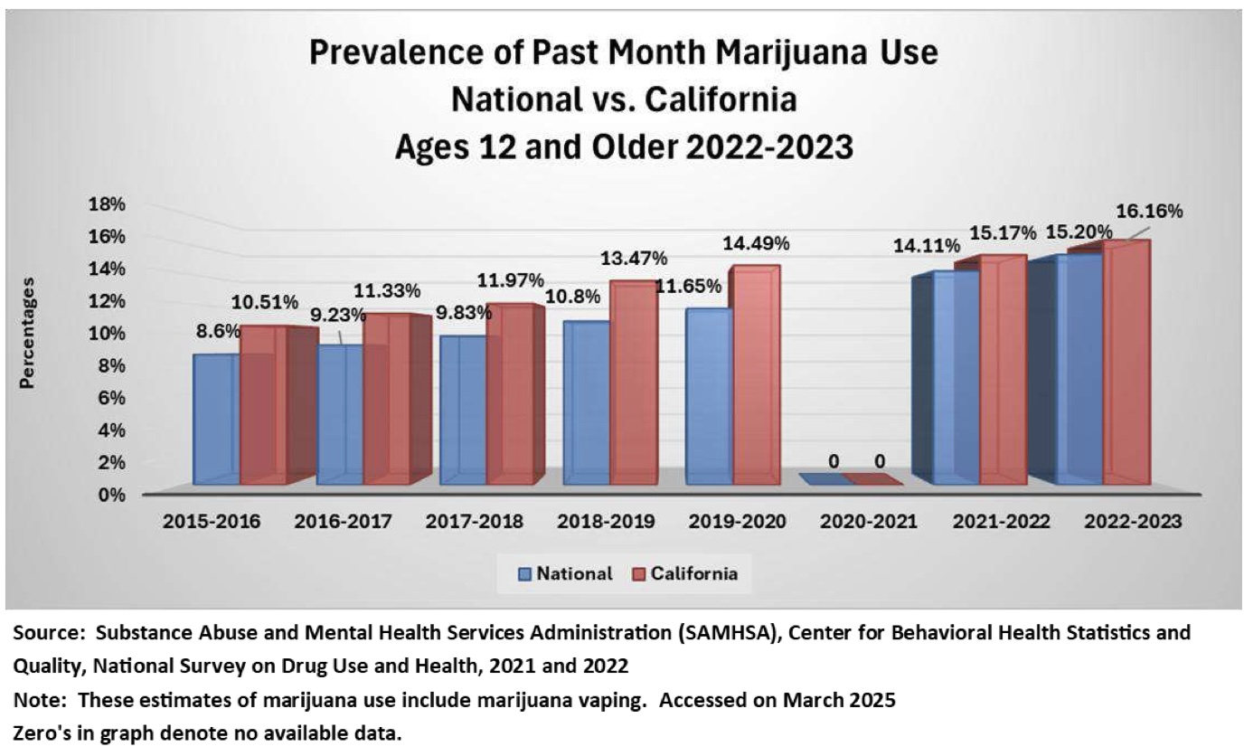

Slide 46
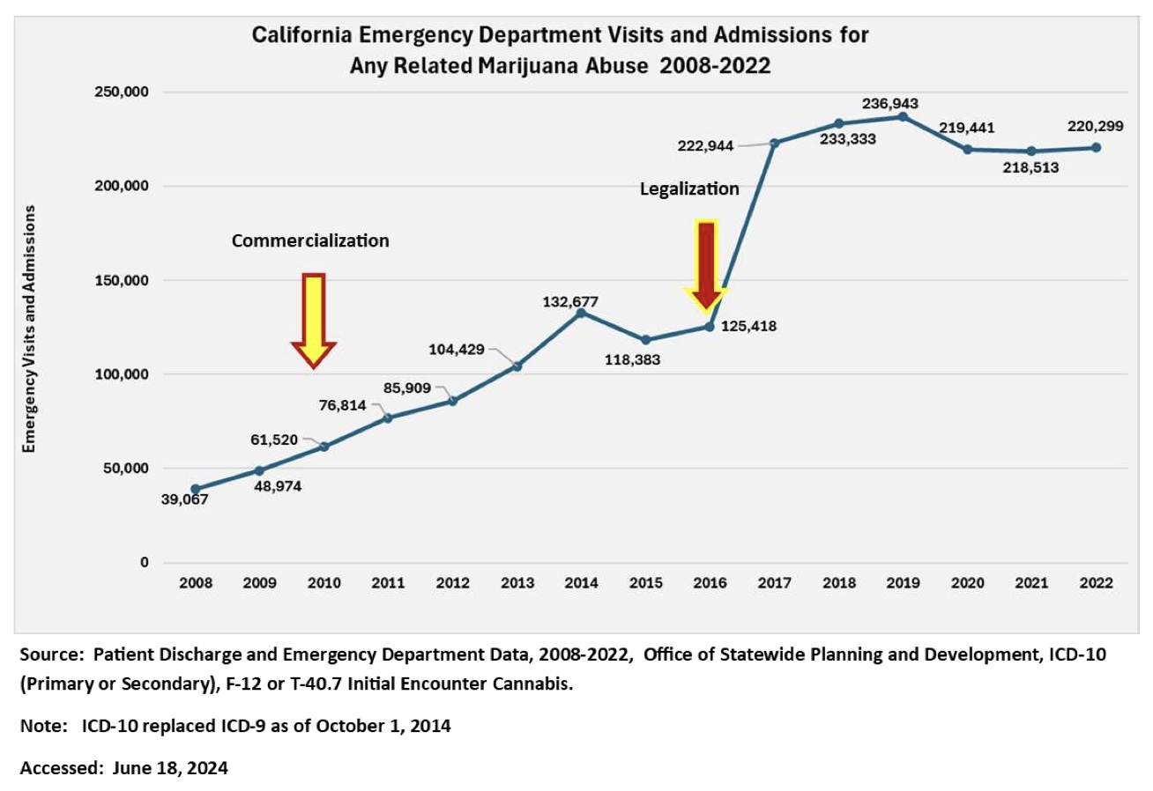

Slide 47
Violence and Crime

Slide 48
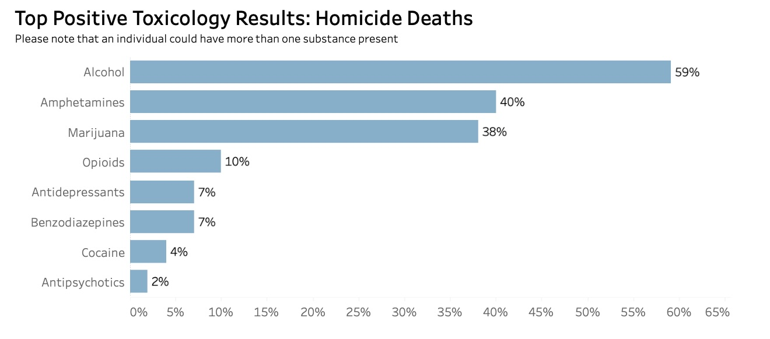

Slide 49
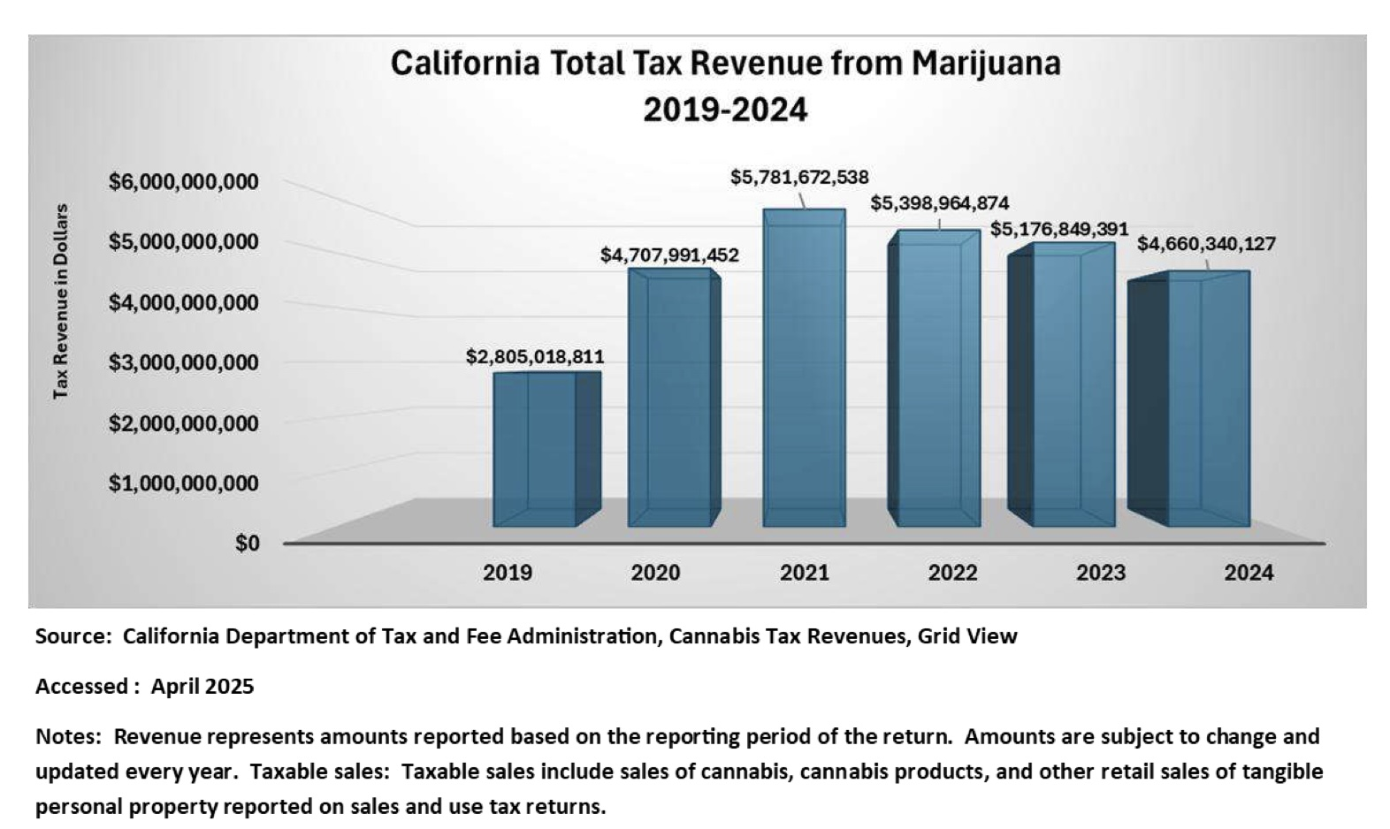

Slide 50
Therapeutic Use of Cannabis and Cannabinoids
November 2025, JAMA
Conditions for which cannabinoids have approval from the US Food and Drug Administration include
    HIV/AIDS–related anorexia
    chemotherapy-induced nausea and vomiting
    certain pediatric seizure disorders.
https://jamanetwork.com/journals/jama/article-abstract/2842072

Slide 51
Therapeutic Use of Cannabis and Cannabinoids
Evidence-based guidelines do not recommend the use of inhaled or high-potency cannabis (≥10% or 10 mg Δ9-tetrahydrocannabinol) for medical purposes
High-potency cannabis compared with low-potency cannabis use is associated with increased risk of psychotic symptoms and generalized anxiety disorder
29% of individuals who used cannabis for medical purposes met criteria for cannabis use disorder
https://jamanetwork.com/journals/jama/article-abstract/2842072

Slide 52
Therapeutic Use of Cannabis and Cannabinoids
Daily inhaled cannabis use compared with non-daily use was associated with an increased risk of coronary heart disease, myocardial infarction, and stroke.
Evidence from randomized clinical trials does not support the use of cannabis or cannabinoids for most conditions for which it is promoted, such as acute pain and insomnia.
https://jamanetwork.com/journals/jama/article-abstract/2842072

Slide 53
Cannabis education: how providers and
patients can engage in discussion
June 2023; Journal of Legal Medicine
Drug interactions: recommend a discussion with the patient and pharmacist due to the hundreds of known drug interactions, some of which can be life-threatening.
Cannabinoids are metabolized via the liver’s cytochrome pathways which could have significant adverse health consequences due to drug-drug interactions
https://link.springer.com/article/10.1007/s00414-023-03041-x

Slide 54
  Action Plan
Monitor public health impacts and publish regularly to public, including health care utilization and costs
Consumer registration (name, number, email) at dispensary in event of recall
PDMP-like program to monitor patient and providers (pill mills)
Massive education campaign beginning in elementary school
Delay onset of use until 25 or later
Restrict potency to 10%

Slide 55
  Action Plan
Track child fatality/neglect data and publish publicly
Monitor driving fatality data
Gather in utero substance exposure data
Drug test mandates on violent crime
Restrict advertising to youth
Eliminate home grows: no state revenue, breeding ground for illegal activity

Slide 56
  Action Plan
Discourage use during pregnancy/lactation
Discourage smoking/vaping (EVALI)
Drug test mandates on all suicide, particularly youth
Money for law enforcement
Warning labels/dosing guidelines
Bonafide doctor-patient relationships/medical records

Slide 57
