Slide 1
Why Cannabis is NOT the solution for PTSD and Concerns for the Increased Use by those 65 and older
Libby Stuyt MD
Psychiatrist - Salida, Colorado
International Academy on the Science and Impact of Cannabis
Virtual Presentation for the South Dakota Medicinal Marijuana Oversight Committee
October 22, 2025

Slide 2
Disclosures
I have no financial relationship with any pharmaceutical company, or any part of the alcohol, tobacco or marijuana industries
I am a board-certified psychiatrist in Colorado and was the medical director of a 90-day inpatient treatment program funded by the State of Colorado for 20 years
I am on the board of IASIC – International Academy on the Science and Impacts of Cannabis www.IASIC1.org

Slide 3
A growing number of states have identified PTSD as an approved condition for medical marijuana without any rigorous scientific studies backing this up
As of February 2025, the Colorado Medical Marijuana Registry indicates there are 61,383 individuals with medical marijuana cards and 11,095 are for PTSD
Medical marijuana statistics and data | Colorado Department of Public Health and Environment

Slide 4
My Experience with CUD in a 90-day Inpatient
Co-occurring Treatment Program in Colorado
Year N %Completion of Program % Reporting Use of Cannabis % Reporting Tobacco Use
2014 66/83 80% 73% 88%
2015 62/86 72% 80% 89%
2016 56/85 66% 89% 89%
2019 37/70 53% 95% 91%
Primary psychiatric disorder treated was PTSD, 80% admitted as a condition of Probation
In Colorado, people on probation can use medical marijuana if a doctor recommends it.
The numbers with cannabis use disorder as their primary drug problem increased significantly after legalization.
2015 – 4%
2016 – 9%
2019 – 14%
Seeing increasing cognitive problems, psychotic symptoms, fixed delusions, cannabinoid hyperemesis syndrome, problems with violence in those using high potency THC marijuana

Slide 5
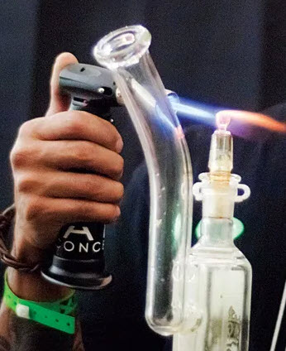
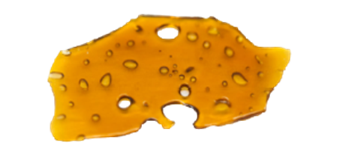
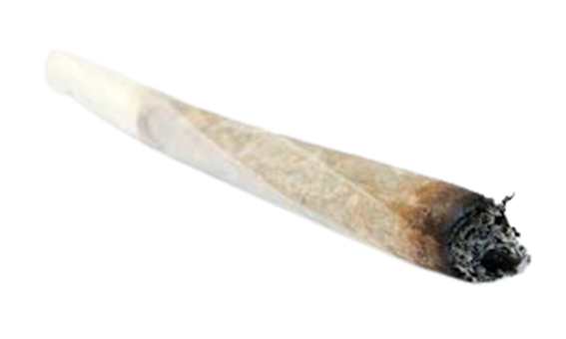
Commercialization has radically changed marijuana
THEN NOW
Today, THC potency in products like shatter can
exceed 90%.
They are smoked in a rig using a butane torch.
Before 2000,
THC Potency in Marijuana was 4-5%

Slide 6
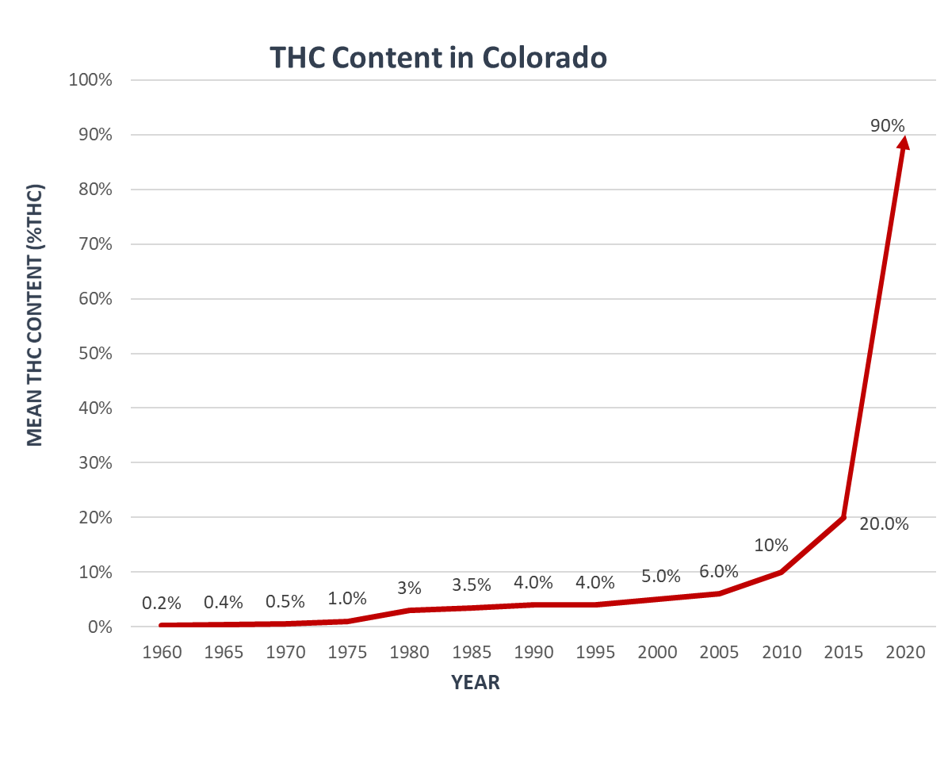
MASSIVE INCREASE IN THC POTENCY IN COLORADO
Research supporting the use of dispensary cannabis for medical purposes is on THC less than 10%
We have no research that shows high potency products are safe or effective for any medical condition
Multiple studies show serious problems with high THC: addiction, psychosis, depression, anxiety, sleep problems, suicide, violence.
Mahmoud A. Elsohly (2014) Potency Monitoring Program, Supported by NIDA (years 1960-2015), and Colorado Department of Health and Environment, THC Concentration in Colorado Marijuana (year 2020)

Slide 7
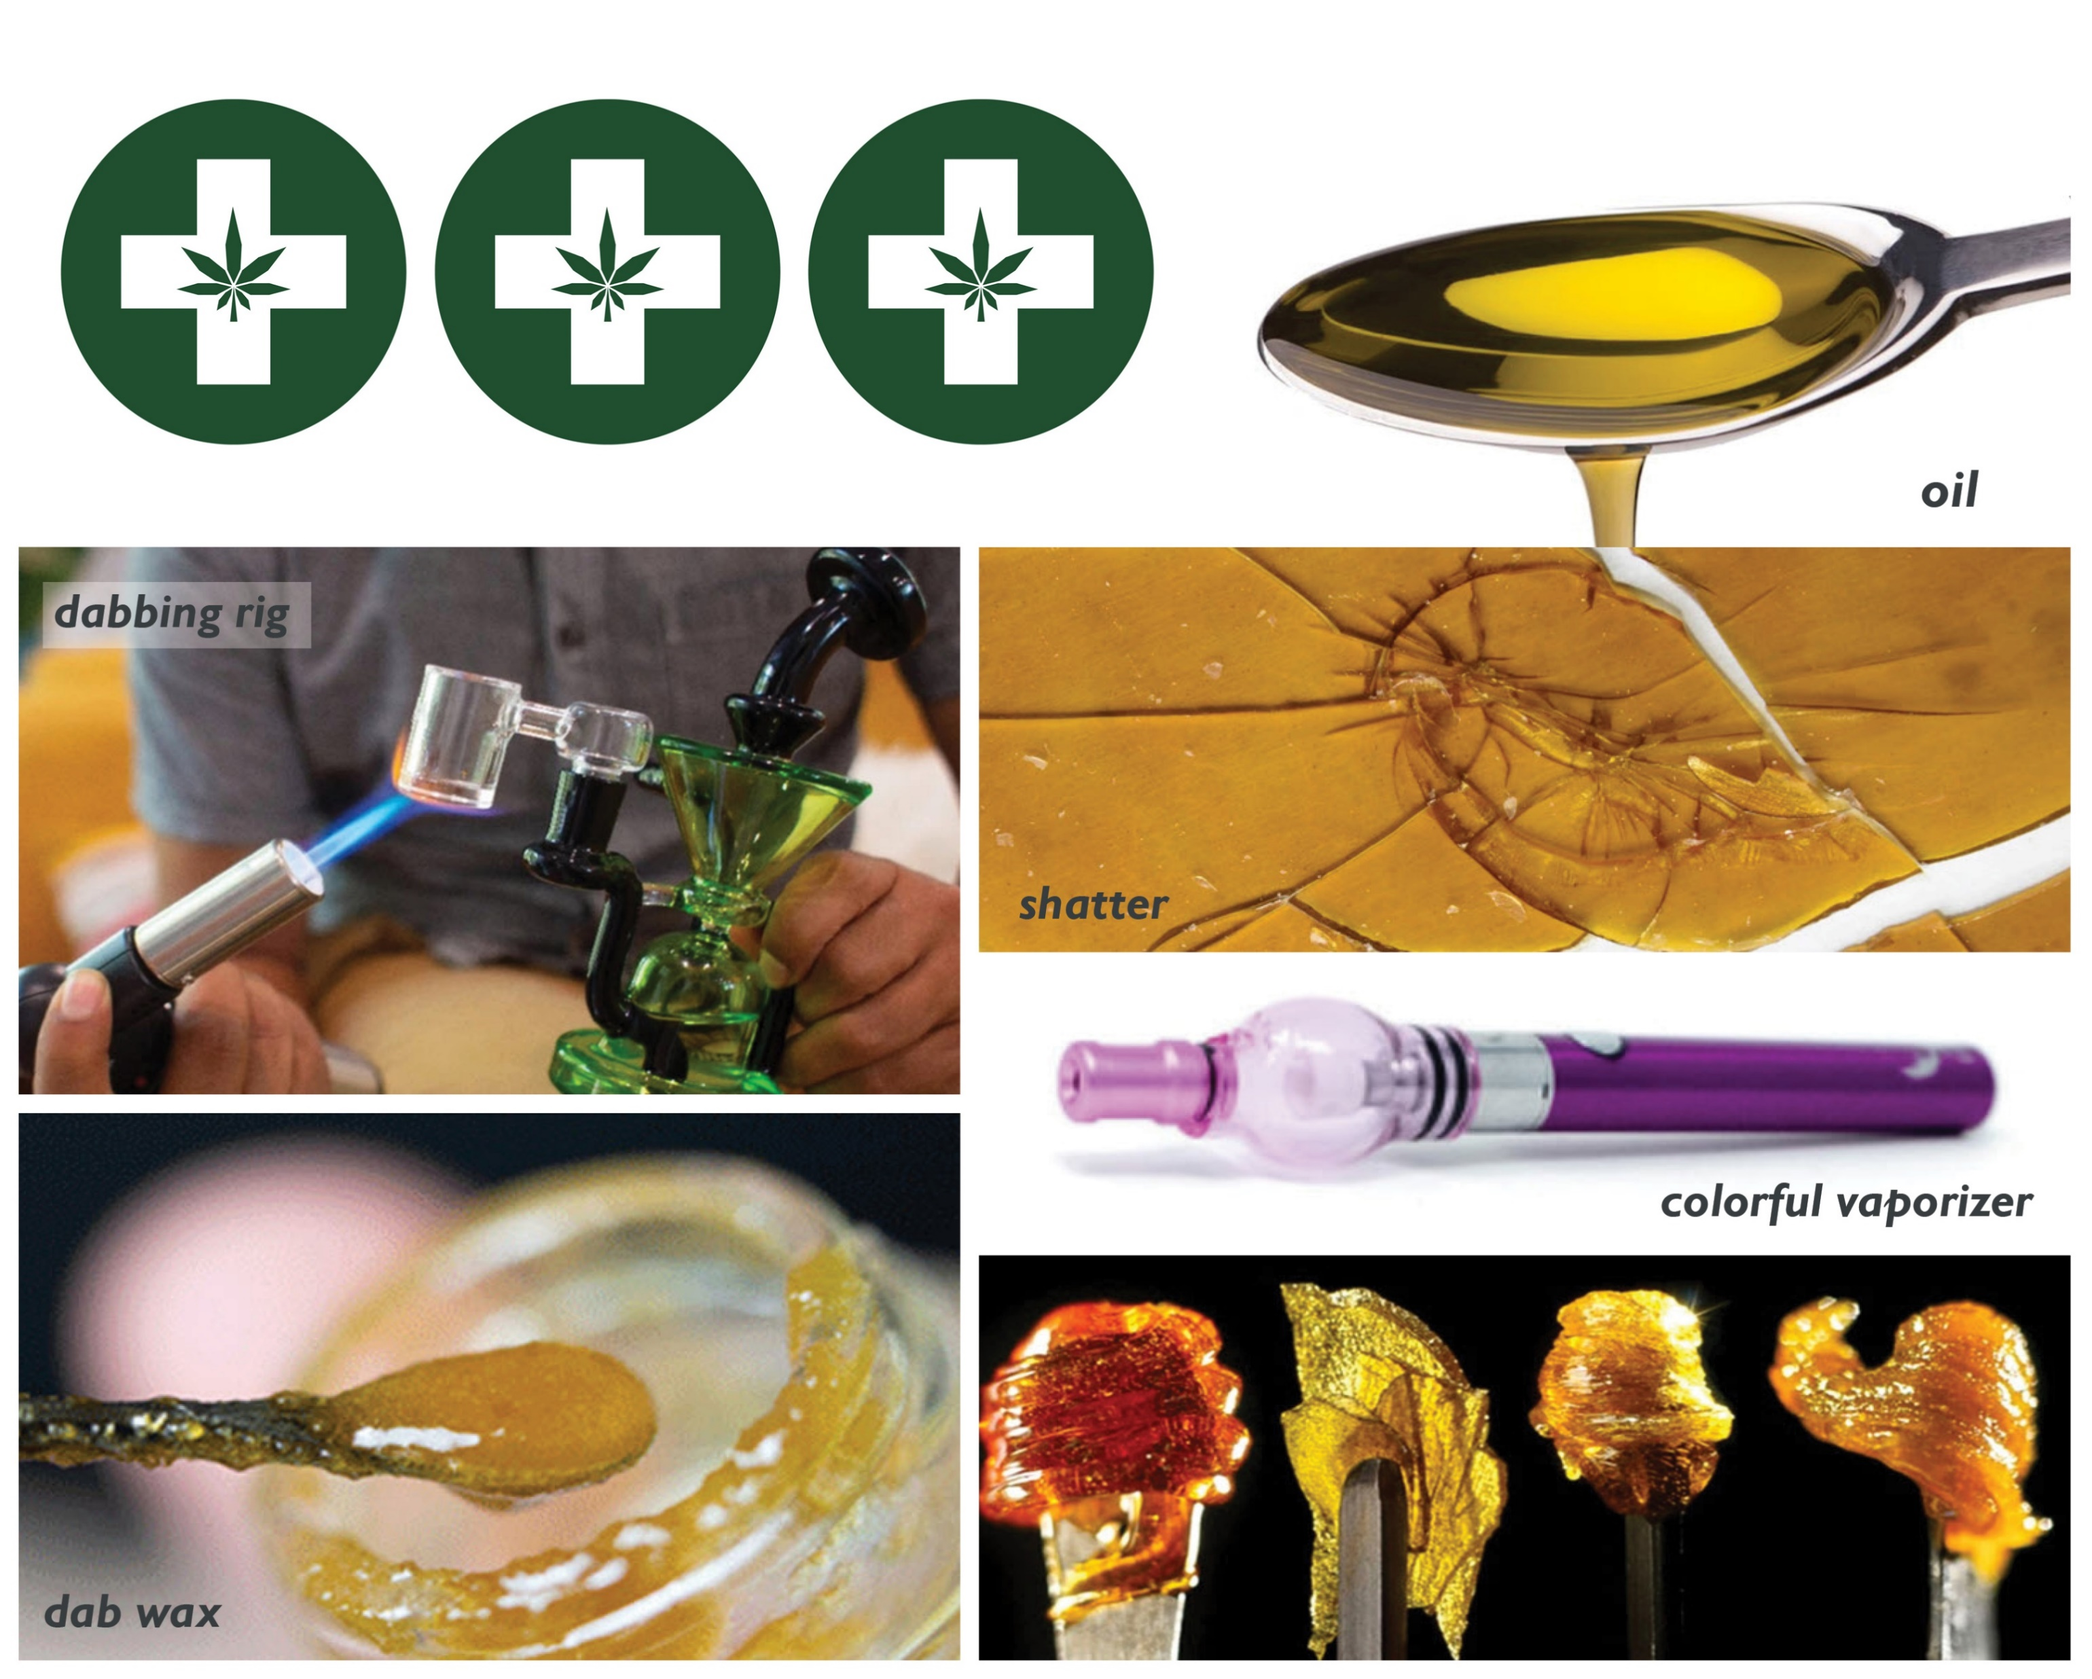
KIDS AND ADULTS THINK IT’S SAFE BECAUSE IT IS
AGGRESSIVELY MARKETED AND SOLD AS MEDICINE
The use of e-cigarettes and vape devices by youth has rapidly increased, driven in part by marketing and advertising
JAMA Pediatrics 2019;143(6):e20182741
Among adolescents reporting use of vape products in Colorado, 50.1% reported using marijuana in the past 30 days versus 7.6% of those not using vape products.
NEJM 2019;380:689-690
There has been a significant increase in dabbing and edible use among adolescents in Colorado since 2015.
JAMA Pediatrics 2019;173:988-989
Colorado Healthy Kids Survey, 2019

Slide 8
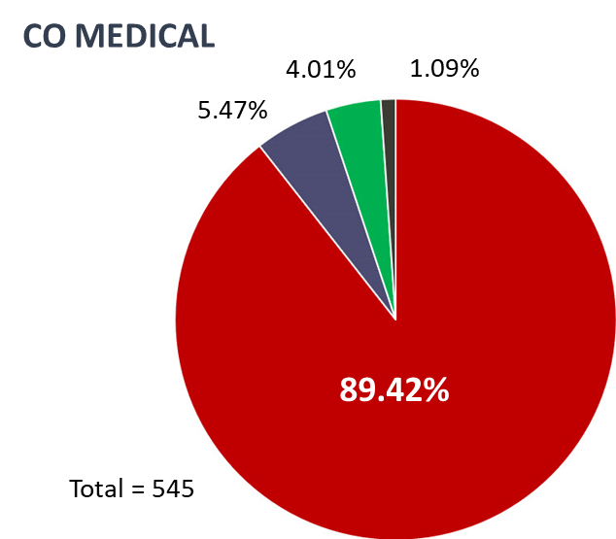
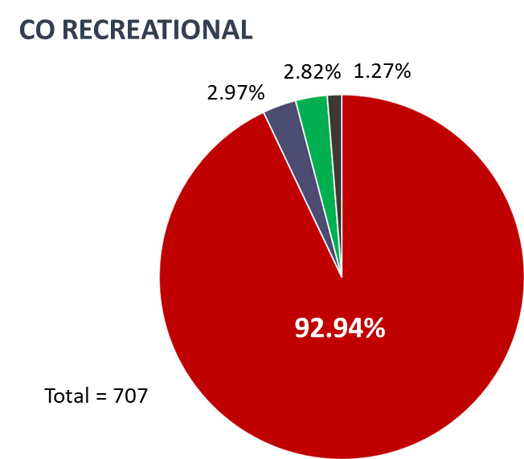
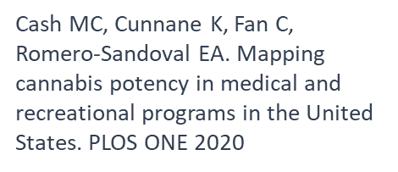
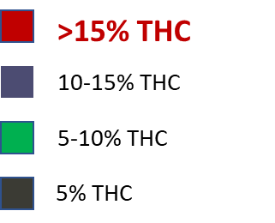
MOST PRODUCTS AVAILABLE IN COLORADO MEDICAL AND RECREATIONAL DISPENSARIES CONTAIN
GREATER THAN 15% THC
Prior to HB21- 1317 twice as much could be bought daily in medical versus retail (40 grams vs 20 grams per day), taxes significantly lower, no marijuana recommendation specifications or monitoring

Slide 9
By 2022 there were only 2 randomized, controlled clinical trials for PTSD patients. The first used the synthetic cannabinoid nabilone.
The efficacy of nabilone, a synthetic cannabinoid, in the treatment of PTSD-associated nightmares: A preliminary randomized, double-blind, placebo-controlled cross-over design study Jetly R et al. Psychoneuroendocrinology 2015;51:585-588.
10 military males with chronic PTSD in Canada, dosed up to 3 mg/day for 7 weeks, one daily dose one hour before bedtime, avg dose 1.95 ± 0.9 mg, 9 males in the placebo group
The nabilone group experienced reduced nightmares and improved general well being compared to the placebo group.
Very small sample size, short duration, needed to be replicated

Slide 10
RCT of cannabis for PTSD failed to show any benefit over placebo Bonn-Miller MO et al. PLOS ONE 2021
randomized, double-blind, placebo-controlled, crossover trial of smoked cannabis containing three different concentrations of THC and CBD, and placebo
High THC = approximately 12% THC and < 0.05% CBD); High CBD = 11% CBD and 0.50% THC; THC+- CBD = approximately 7.9% THC and 8.1% CBD, and placebo = < 0.03% THC and < 0.01% CBD. Participants were provided 37.8 grams (1.8 grams/day)for the three-week ad libitum treatment period
Total cannabis withdrawal symptoms averaged in the moderate range for all treatment groups at the start of Stage 1 (despite two weeks of abstinence prior to randomization), then generally reduced to the mild to moderate range by the end of treatment in Stage 1. Participants who received High THC in Stage 1 reported a significant increase in withdrawal following one week of cessation from Stage 1 treatment, which averaged in the moderate range following cessation
This study failed to find a significant group difference between smoked cannabis preparations containing High CBD, High THC, and THC+CBD against placebo in regard to their impact on PTSD symptoms

Slide 11
Medical cannabis for treatment-resistant combat PTSD Nacasch N, Avni C, Toren P. Front. Psychiatry 2023 13:1014630.
retrospective naturalistic study, 14 relatively mature (32-68 years of age), treatment-resistant, chronic combat post traumatic patients
All patients reported only using cannabis before going to sleep, and no patient reported or displayed any sign of cannabis misuse
amount of cannabis did not exceed 20 grams per month (0.66 grams/day)
Overall improvement in sleep quality and duration, as well as a decrease in PTSD symptoms reduction of at least 20% in PTSD symptoms in over 65% of patients, with nearly 80% showing improvement.
Authors emphasize importance of selection process
Notes:
12 men 2 women
Thewidespreaduseof cannabis today inpatientswithPTSD, whether legally or otherwise, is often problematic due to the onset of use at ayoungage and thepotential for addictionand dependence(
There isalsoaproblemwithpatientspreferringcannabis treatment as their first treatment over evidence-based pharmacological andpsychological treatmentsInour study, the pre-selection process created amostly homogeneous group of relativelymature patientswithout prior use of cannabiswho were treatment-resistant to several evidence-based therapies. By selectingthisgroup,wehaveshownthatcannabismaybebeneficial andalleviatesomesufferingamongpatients resistant toevidence basedtreatments.
Israel has one of the longest-running medical cannabis programs in the world, starting in the 1990s (32). However, the use of medical cannabis for PTSD in Israel began only in 2014

Slide 12
Effects of Δ9 -tetrahydrocannabinol on aversive memories and anxiety: a review from human studies Raymundi AM et al. BMC Psychiatry 2020; 20: 420
A review of peer reviewed studies and RCT in humans 1974-2020 of THC or THC and CBD in PTSD
Low doses of THC (7.5 mg THC) potentiate fear memory extinction in healthy volunteers and reduce anxiety responses in anxious and PTSD patients without inducing a psychotic effect.
High doses of THC (greater than or equal to 10% THC), however, do not facilitate fear memory extinction and are related to clinically relevant anxiogenic and psychotic effects in healthy volunteers.

Slide 13
Why Cannabis is NOT the solution for PTSD
Reasons why Cannabis is not the answer
  Temporary relief – numbing, disconnecting from the traumatic emotions
  In order to keep symptoms at bay one must use daily, if not multiple times a day
  This can result in cognitive impairment, a-motivational syndrome, potential for psychosis or worsening psychosis from PTSD
  Addiction potential - CUD and a vicious cycle of withdrawal symptoms
  False memories

Slide 14
Marijuana Use is Associated with Worse Outcomes in Symptom Severity and Violent Behavior in Patients with PTSD Wilkinson et al. J Clin Psychiatry. 2015 September ; 76(9): 1174–1180
Observational study of 2276 Veterans treated in VA PTSD treatment programs 1999-2011
  Never used marijuana – significantly lower symptom severity 4 months later
  “Starters” – highest levels of violent behavior and PTSD symptoms 4 months after treatment
  “Stoppers” – lowest level of PTSD symptoms at 4 months after treatment
  initiating marijuana use after treatment was associated with worse PTSD symptoms, more violent behavior and alcohol use

Slide 15
Short and Long-Term Effects of Cannabis on Symptoms of Post-Traumatic Stress Disorder LaFrance EM et al. J Affective Disorders 2020;274:298-304
Anonymous data from Strainprint® for 404 medical cannabis users who self-identified as having PTSD and who used the app to track symptoms of intrusive thoughts, flashbacks, irritability, and anxiety.
Users indicate the strain of cannabis that they are about to use as well as the producer/distributor of that strain by choosing from a selection of over 3,000 cannabis products sold in Canada.
Results indicate that acute cannabis intoxication provides temporary relief from intrusions, flashbacks, irritability, and anxiety. However, baseline PTSD symptom ratings did not change over time, and they detected evidence that people used higher doses to manage anxiety over time, which may be indicative of the development of tolerance to the drug.
Collectively these results indicate that cannabis may reduce PTSD symptoms in the short-term but may not be an effective long-term remedy for the disorder.

Slide 16
Prevalence and Correlates of Cannabis Use in an Outpatient VA Posttraumatic Stress Disorder Clinic
Gentes EL et al. Psychol Addict Behav. 2016 May ; 30(3): 415–421
Male veterans (N = 719) who presented at a VA specialty outpatient PTSD clinic completed measures of demographic variables, combat exposure, alcohol, cannabis and other drug use, and PTSD and depresssive symptoms.
14.6% of participants reported using cannabis in the past six months.
After controlling for age, race, service era, and combat exposure, past six-month cannabis use was associated with unmarried status, tobacco smoking, other drug use, hazardous alcohol use, and higher clinician-rated global PTSD severity, depressive symptoms, and suicidality.

Slide 17
Frequent cannabis use worsens PTSD symptoms in Veterans
Hill ML et al. (2022). Cannabis use among U.S. military veterans with subthreshold or threshold posttraumatic stress disorder: Psychiatric comorbidities, functioning, and strategies for coping with posttraumatic stress symptoms. Journal of Traumatic Stress, 35, 1154–1166
2019–2020 National Health and Resilience in Veterans Study (NHRVS) 4,069 U.S. military veterans
Compared with veterans who did not use cannabis or used it infrequently, those who used cannabis frequently were roughly twice as likely to screen positive for co-occurring MDD, GAD, and SI; showed small-to-moderate decrements in cognitive functioning; and were 2–6 times more likely to endorse using avoidance strategies as a primary means of managing their PTSD symptoms.

Slide 18
Cannabis use and posttraumatic stress disorder: prospective evidence from a longitudinal study of veterans Metrik J et al. Psychological Medicine 52, 446–456.
Post-9/11/2001 veterans in the Northeast region of the USA returning from deployment in Iraq and Afghanistan (N=361) were recruited between February 2013 and June 2016 to prospectively examine cannabis use and related problems.
All participants resided in a state with medical marijuana laws at the time of data collection. Follow-up visits were conducted in-person at 6 months (N=312; 86.4%) and 12 months (N=310, 85.9%) with parallel assessments.
More frequent cannabis use was associated with greater severity in PTSD-related intrusion symptoms 6 months later and a prospective association from PTSD diagnosis to CUD diagnosis 1 year later.
These findings do not support the widespread state sanctioned medical use of cannabis for the treatment of PTSD.
Notes:
these findings from a rigorous prospective study strengthen the argument for a causal link between frequent cannabis use and subsequent greater severity of PTSD-related intrusion symptoms and the links between PTSD and CUD. there was no evidence of improvement in PTSD-related intrusion symptoms or remis sion in PTSD diagnosis in association with long-term use of cannabis. In other words, there is compelling evidence that a person who frequently uses cannabis is subsequently going to experience greater traumatic intrusion symptoms over time. Associations were also robust to potential confounds such as age and marital status (and more conservatively, robust to all other substance use variables)

Slide 19
Interactive effects of PTSD and substance use on suicidal ideation and behavior in military personnel: Increased risk from marijuana use Allan NP et al. DepressAnxiety.2019;1–8.
examined the interactive effects of PTSD symptoms and heavy alcohol use, opioid use, and marijuana use over the past 30 days, prospectively, on PTSD symptoms, suicidal thoughts, and suicidal behaviors over 12 months in a sample of at-risk service members or veterans not engaged in behavioral health treatment.
545 participants (av age=31.91 years; 88.2% male, 31.6% married)
Participants completed follow‐up interviews at 1, 3, 6, and 12 months. Payments up to $150 were sent via mail for participation in the study
Heavy drinking was not predictive of increased suicidal ideation or suicidal behavior and there was no significant associations among past 30 days opioid use, and the suicide‐related variables assessed.

Slide 20
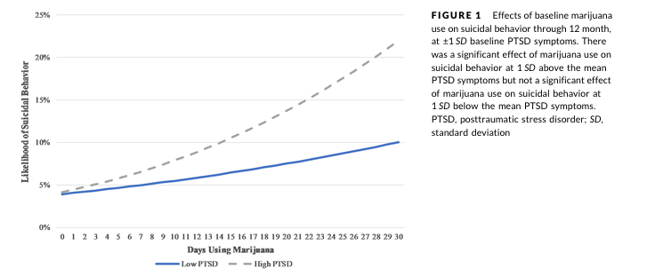
Days using marijuana significantly predicted an increased likelihood of suicidal ideation 1 month later. Marijuana use also predicted an increased likelihood of suicidal behavior as well as less of a decline in PTSD symptoms over the following year for those with elevated PTSD symptoms at baseline.
These results suggest that for individuals with elevated PTSD symptoms, using marijuana may exacerbate and/or maintain PTSD symptoms and increase the likelihood of suicidal behavior over time

Slide 21
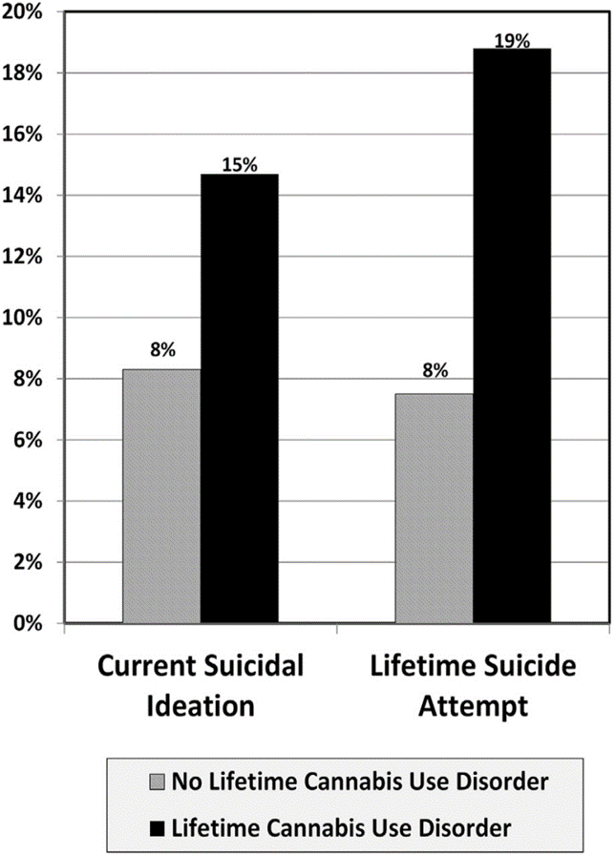
CANNABIS USE DISORDER IS ASSOCIATED WITH
SUICIDE ATTEMPTS AMONG VETERANS
3,233 veterans in cross-sectional, multi-site study by Veterans Affairs (VA).
Cannabis use disorder was significantly associated with both current suicidal ideation and lifetime history of suicide attempts compared to veterans with no lifetime history of cannabis use disorder.
The significant difference persisted even after adjusting for sex, PTSD, depression, alcohol use disorder, non-cannabis drug use disorder, history of childhood sexual abuse and combat exposure.
Kimbrel NA et al. J Psychiatric Research 2017:89;1-5

Slide 22
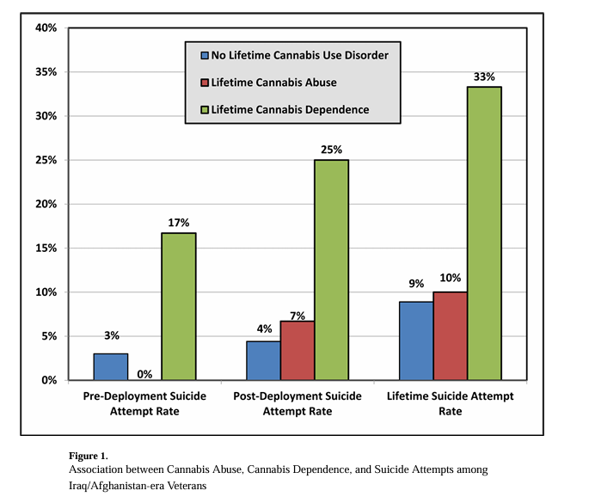
319 Iraq/Afghanistan-era veterans ages 21 to 67 (M = 39.6) Male = 261, Black = 50.5%, White = 38.2%, Hispanic = 5%
Lifetime cannabis dependence was specifically associated with post-deployment suicide attempts, even after accounting for the effects of gender, PTSD-depression, pain, non-cannabis SUD, and pre-deployment suicide attempts.
Cannabis Use Disorder and Post-Deployment Suicide Attempts in Iraq/Afghanistan-Era Veterans
Adkisson K et al. Arch Suicide Res. 2019 ; 23(4): 678–687.

Slide 23
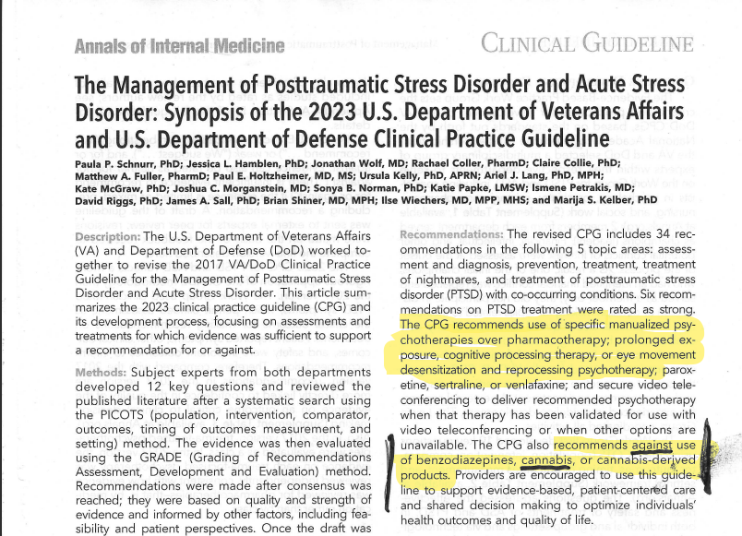
Ann Internal Medicine 2024:177:363-374

Slide 24
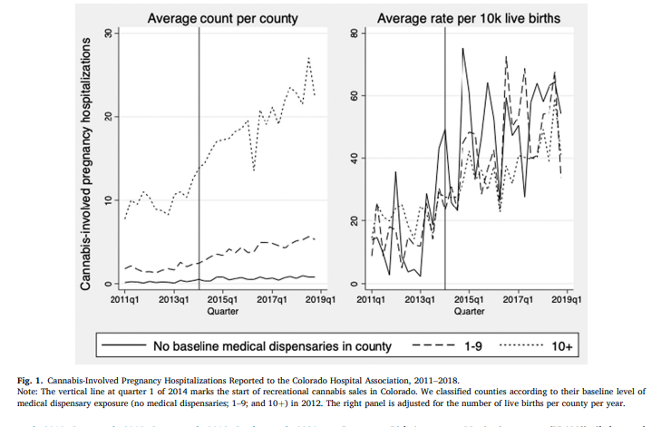
Cannabis legalization and cannabis-involved pregnancy hospitalizations in Colorado
Wang GS et al. Preventive Medicine 156 (2022) 106993
In Colorado, there was more than a two-fold increase in cannabis involved pregnancy hospitalizations between 2011 and 2018.
Highest increase after sale of recreational cannabis began in 2014
Presence of the recreational market may influence cannabis use decisions among pregnant individuals

Slide 25
Trends in emergency department visits associated with cannabis use among older adults in California, 2005–2019
Han BH et al. J Am Geriatr Soc. 2023;1–8.
Retrospective cohort study of adults aged ≥65 - 2005 through 2019 from all non-federal acute care hospitals across the state of California
The cannabis-related ED visit rate increased significantly for adults aged ≥65 and all subgroups (p < 0.001)
20.7 per 100,000 visits in 2005 to 395.0 per 100,000 ED visits in 2019, a 1804% relative increase
Adults aged 75–84 had the largest relative percent change with a 2208.3% increase
Older Black adults had the highest ED visit rate in 2019 and the largest absolute increase while older males had a higher ED visit rate in 2019 and a greater absolute increase than older women

Slide 26
Drug: Drug Interactions with Cannabis
ASRA pain medicine consensus guidelines on the management of the perioperative patient on cannabis and cannabinoids. Shah S et al. Reg Anesth Pain Med 2023;0:1–21. doi:10.1136/rapm-2022-104013
All patients should be questioned about cannabinoid use, dose and frequency, route of administration, and time of last use
Cannabinoids can produce significant physiologic changes and can potentially interact with anesthetics that can lead to complications
Patients taking cannabinoids preoperatively may also report increased postoperative pain levels, which could affect perioperative management.
In the perioperative setting, special attention should be paid to potential cannabinoid interactions with warfarin, direct oral anticoagulants, and clopidogrel – but there are many more drug: drug interactions

Slide 27
Many People use Cannabis to help with Sleep HOWEVER
Sleep-promoting effects are more observable among cannabis-naïve individuals during initial use, whereas chronic cannabis use is thought to disrupt sleep due to dysregulation in ECS from prolonged exposure to THC
Sleep disturbances such as shorter sleep duration, reduced rapid eye movement (REM) sleep, and slow wave sleep (SWS) are often reported in individuals who use cannabis at a higher rate compared to those who do not use cannabis.
Reductions in REM and SWS are known to impair hippocampal-dependent learning, and inhibit memory consolidation, respectively.

Slide 28
The role of sleep in the link between cannabis use and memory function: evidence from a cross-sectional study
Brown T et al. AM J OF DRUG AND ALCOHOL ABUSE 2024, VOL. 50, NO. 4, 547–556
141 adults with CUD (83 men, 18–31, M = 22.78, NL: 79; US: 62) and 87 non-CUD controls (39 men, 18–30, M = 23.04, NL: 48; US: 39).
Adults with CUD were defined as using cannabis >5 days per week during the previous year and with mild to severe CUD
Visual special learning and memory tested - Short Visual Object Learning Task (sVOLT) and the Short Visual Object Learning Task delayed (sVOLTd), Verbal memory tested by N-back task
CUD increased reported sleep difficulties and sleep difficulties related to poorer learning and memory performance (i.e. decreased efficiency scores), and (2) sex did not moderate these relationships
Notes:
Participants com pleted the sVOLT to assess their immediate recall of 20 shapes, then completed other Penn CNB tasks for ~19 minutes before assessing their delayed recall with the sVOLTd that consisted of correctly identifying 10 pre viously presented shapes after a 1 minute time delay. Verbal memory was assessed using the N-back task with letter stimuli collected during a functional MRI scan (41–43). The task consisted of 12 blocks with 3 memory loads that were presented 4 times in a fixed order beginning with high memory load (2-back), fol lowed by recognition (0-back), and low memory load (1-back). The participants were instructed to indicate if the letter presented on the screen matched a previous letter displayed by pressing a target or non-target for 1- back and 2-back trials. For the 0-back trials, participants were asked to indicate only when the letter “X” was presented. Participants were not provided with feedback during or after the task

Slide 29
CBD and Liver Enzyme Level Elevations in Healthy Adults
Florian J et al. JAMA Internal Medicine 2025:185;1070-1078
The wide use of unregulated CBD products raises safety concerns
In 201 healthy participants, 8 participants in the CBD group and 0 participants in the placebo group had liver enzyme level elevation greater than 3 times the upper limit of normal.
Seven participants met withdrawal criteria for potential drug-induced liver injury, detected at day 21 in 2 participants and day 28 in 5 participants.
Doses of 5 mg/kg/day – 350 mg - range 200 mg – 400 mg
Compared to Epidiolex (Rx CBD) 25 mg/kg/day – 1,750 mg (70 kg person)
A increased risk of liver enzyme level elevation was observed. Liver enzyme level elevations typically occurred after 2 weeks and were dose dependent

Slide 30

Questions?
libbystuyt@msn.com

